Slide 1
SSEN Flexible Connections
WCA Energy Topic Group
16th February 2021
Alex Howison, SSEN Flexible Solutions Manager

Slide 2

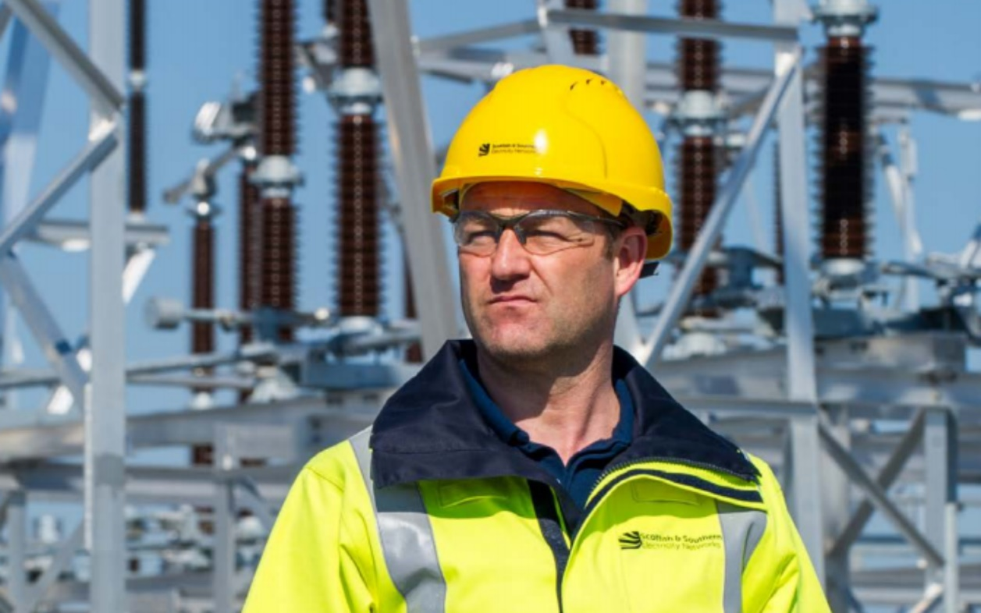
Agenda
The Network
Connections Information & Support
Why we Need Flexible Solutions
Types of Flexible Connections
Progress to Date
Flexibility Services
Future Developments

Slide 3
The Network
Design
Deliver
Support

Slide 4
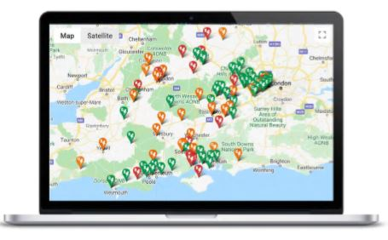
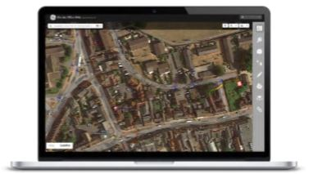





Information and Resources Available to You
Network information available on our website
Demand and Generation Availability Maps
Geographical Information System (GIS)
Long Term Development Statements (LTDS)
G81 Library (technical policies and standards)
Loading and Rating Information and High Voltage Schematics
Connection Offer Expenses (COE)
COEs are the costs associated with preparing a Connection Offer for a large Generation or Demand project. You can find more information as well as a detailed guide here.
Contact Guides
Details of who to contact during each stage of your connections journey, as well as escalation points, compliments and complaints processes are available here.
Different Types of Quotes
Information and Resources Available to You
Videos
Please visit our YouTube channel to browse playlist of webinars we have held and videos we have made this year.
Electric Vehicles (EVs)
Information on EV connections can be found here. Our Account Management team are on hand to support any further queries you might have..
Flexible Connections
Find out more about our Active Network Managed (ANM) Zones, intertrip, timed, or export limiting options here.
Wayleaves and Land Rights Information
For more information on wayleaves and land rights, please visit our Land Rights webpage here.
Site Readiness Guides
We have site readiness guides detailing what you need to have prepared on site before we attend your site and energise your connection. There are three guides for different sizes of developments available on our website.
Site Readiness guide for Small Connections
Site Readiness guide for Large Connections above 100A
Interactivity
Find out more about interactivity here
Statement of Works
Find out more about Statement of Works here
 | Budget Estimate | Feasibility Study | Connection Offer
Involves network studies
Can be accepted and progressed to a firm offer
Suitable for | Customers considering a connection who are not yet ready to apply for a connection offer | Customers considering more complex projects who wish to investigate multiple connection options | Customers looking to progress a formal application to a connection offer
Charged service? | No | Yes | Yes

Slide 5






Key Contacts
Account Managers
Our Account Managers are involved throughout the connections journey and can be contacted at any stage.
If you would like to book in a meeting regarding one or more prospective projects, or discuss projects already in progress, please get in touch.
See our Connections Meetings leaflet
Book a meeting through our events calendar
Contact our Account Management team directly at commercial.contracts@sse.com
Key Contacts
Connections Engagement
Our Connections Engagement team are involved throughout the connections journey and can be contacted at any stage.
The team is responsible for the Incentive on Connections Engagement and run events, workshops, webinars and surveys to ensure we provide excellent customer service and listen to our stakeholders’ views on how we can improve our business.
To get involved with our engagement, get in touch with our Connections Engagement team.
Visit our website to see our annual ICE Reports featuring our yearly commitments and improvements
Sign up to our mailing list to be notified when we host our next event, webinar, survey or consultation
Keep an eye on our online event calendar and sign up to the events that interest you

Slide 6
Why do we need Flexible Solutions?
Networks are becoming more constrained as more DER connects
Need for cheaper, quicker connections is apparent
Use what we have more intelligently, efficiently and only reinforce where needed
Transmission and Distribution drivers (SWAN)
Transition to DSO
Connect quicker ahead of reinforcement
Customers have an option
Alternative to reinforcement

Slide 7
Flexible Solutions Overview
Design
Delivery
Support
Flexible Connections
ANM
Timed
3rd Party ANM
G100
Flexible Services
Sustain
Dynamic
Restore
Secure

Slide 8
March ‘18
Flexible Connections Go-live
May ‘18
First quotations issued within new process
October ‘18
First connections delivered within new process and SSEN ‘Minimum Scheme’ Policy change development
April ’19
Minimum Scheme Process delivered and directly contributes to industry policy change DCP 348 – recognising flexible connections as equivalent to traditional options
Today
SWAN Project in delivery, ANM enabling over 60% of SEPD licence area (Completion due Oct 2021)
ANM Centralisation Project in delivery (completion due Nov 2020)
Older ANM systems on Orkney and Shetland being refreshed in ‘20-’21
SSEN maintains the widest suite of flexible connections in the UK
Story so Far – Flexible Connections
2011 ORKNEY RPZ – ANM Genesis
SSEN Delivers first UK ANM System in the Orkney Registered Power Zone
2013 NINES – SHETLAND ANM
SSEN Delivers first UK ANM managing generation, demand and storage – the UK’s first Smart-Grid
2016 IOW ANM
SSEN Delivers UK’s first BAU ANM System alongside ‘trial’ connections of the wider suite across the licence areas

Slide 9
Story so Far – Flexible Connections
Flexible connections connected to date
DG capacity across our licence areas.
Saved connecting customers over 90 years (yes, years!)
Cost of reinforcement saved by the customer
70 Connections in the pipeline Totalling over 1GW of new flexible generation
93
412.5MWs
90
£58M
70
1GW

Slide 10
  Flexible Connection Application Process
Generation Application
£50K Thermal Reinforcement
Possible Flexible Connection
Customer Quotation
Standard Application Process
Direct Application Process

Slide 11
CMZ Service Types
Sustain (Prevent)
Utilisation and Availability
Reinforcement avoidance or deferral based on peak lopping forecasted demand
Secure (Prepare)
Utilisation
Needed to support the network during networks faults
Dynamic (Respond)
Restore
Utilisation
Utilisation and Availability
Required to support the network during planned maintenance work
Required to support the network during fault conditions while there are planned outages

Slide 12
Story so Far – Flexible Services
CMZ flexible services procured.
CMZ services utilised
240MW
5GWh

Slide 13
Future
Reducing costs for customers
Increasing optionality visibility to customers
Storage and demand flexible connections
Voltage control. Providing options to all customers
Reducing timescales

Slide 14
  Contact Details for the FS Team
Flexible Connections – FlexibleConnections@sse.com
Flexible Services – FlexibleServices@sse.com

Slide 15
  Useful Website Addresses
https://www.ssen.co.uk/1connections/Flexible/
https://www.energynetworks.org/electricity/futures/open-networks-project/workstream-products-2020/ws1a-flexibility-services.html

Slide 16


