Slide 1
Members meeting Wednesday 6th January 2021

Slide 2
WCA Members meeting 6th January
Agenda
Welcome
News and events in January
MP Meetings
The Incinerator
Wiltshire Local Plan consultation
WC Full Council Meeting 23rd Feb 2021 (planning day of action)
Breakout session
Next Meeting and AGM
AOB

Slide 3
WCA Members meeting 6th January
Agenda
Welcome
News and events in January
MP Meetings
The Incinerator
Wiltshire Local Plan consultation
WC Full Council Meeting 23rd Feb 2021 (planning day of action)
Breakout session
Next Meeting and AGM
AOB

Slide 4
Zoom Meeting Protocols
Please stay muted unless you need to talk.
Do make use of the chat function - monitored by Chris
Breakout rooms - chat function only works in room, muted on return, re-join if lost!
Gallery View – to see everybody
Hand-up and claps!
Let’s keep discussions to the point and brief please – Let everybody have a say

Slide 5
WCA Members meeting 6th January
Agenda
Welcome
News and events in January
MP Meetings
The Incinerator
Wiltshire Local Plan consultation
WC Full Council Meeting 23rd Feb 2021 (planning day of action)
Breakout session
Next Meeting and AGM
AOB

Slide 6
WCA Members meeting 6th January
News and Events in January
WCA Environment page starts in Wiltshire Times
13th January -WC Environment Select Committee receive latest from WC Climate Task Group
Wiltshire Local Plan Consultation starts
22nd January -MP Meeting 4pm
27th January -Potential Strategic Planning meeting on Incinerator
30th January -WCA AGM and local group review
Also, all Topic Groups will be meeting in January. Go to website to get details

Slide 7
WCA Members meeting 6th January
Agenda
Welcome
News and events in January
MP Meetings
The Incinerator
Wiltshire Local Plan consultation
WC Full Council Meeting 23rd Feb 2021 (planning day of action)
Breakout session
Next Meeting and AGM
AOB

Slide 8
WCA Members meeting 6th January
MP Meeting – 22 January
John Glenn only to confirm
Others holding ‘Climate conference’
What to discuss

Slide 9
WCA Members meeting 6th January
Agenda
Welcome
News and events in January
MP Meetings
The Incinerator
Wiltshire Local Plan consultation
WC Full Council Meeting 23rd Feb 2021 (planning day of action)
Breakout session
Next Meeting and AGM
AOB

Slide 10
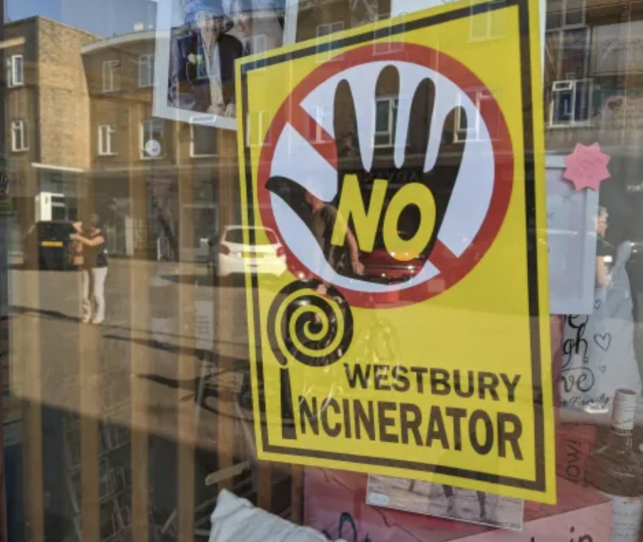
WCA Members meeting 6th January
The Westbury Incinerator
What action we should be taking:
At the Strategic Level
With the Environment Agency

Slide 11
WCA Members meeting 6th January
Agenda
Welcome
News and events in January
MP Meetings
The Incinerator
Wiltshire Local Plan consultation
WC Full Council Meeting 23rd Feb 2021 (planning day of action)
Breakout session
Next Meeting and AGM
AOB

Slide 12
The Wiltshire Local Plan Consultations
What What it’s all about and why you should be involved
Nick Murry (Independent Councillor) will give a briefing

Slide 13
WCA 12th January
The Wiltshire Local Plan Consultation
What the Local Plan is about:
The extent of development (housing numbers)
Where it should go (site allocations)
What form it should take (policies)
Basis for planning permission
Neighbourhood Plans:
Also carry weight as part of the Local Plan (once adopted)
Should be taken account of in the Local Plan
Wilts Council claims to be committed to Neighbourhood Planning (and has one of highest number of any local authority)

Slide 14
WCA 12th January
The Wiltshire Local Plan Consultation
Local Plan (2016-36)
Consultation running from Wednesday 13th January 2021 to Tuesday 9th March 2021
Local Plan Review:
https://www.wiltshire.gov.uk/planning-policy-local-plan-review
Cabinet Paper on Local Plan Review Consultation:
https://cms.wiltshire.gov.uk/ieListDocuments.aspx?CId=141&MId=13087&Ver=4
On line consultation events booking form: https://forms.office.com/Pages/ResponsePage.aspx?id=XudGVeE7E0iw_yZlHqL-GSHf4zXZ6chNp_0GHTuWxRlUM0VVRzc1QkFBVENLWEs2UFA3MFZUQzA0WC4u

Slide 15
WCA 12th January
The Wiltshire Local Plan Consultation
Timeline for the Local Plan Review on WC website (with questions):
Initial consultation on the scope of plan: Commenced Nov 2017 Question: Who was consulted? Not the public
Plan preparation (including informal consultations 2017-21)
Question: Why no public consultation until Jan 2021? Plan seems to have been predetermined
Publication of plan for pre‐submission consultation: Quarter 4 2021
Submission to Secretary of State: Quarter 3 2022
Examination (including hearing and receipt of Inspector's report): Commencing Quarter 4 2022
Adoption: Quarter 2 2023

Slide 16
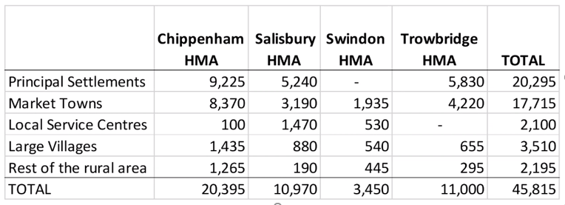
WCA 12th January
Local Plan Review (2016-36)
Proposed housing market area (HMA) ‘allocations’
Housing targets:
include house prices as a predictor of ‘local demand’;
bear no relation to local housing needs;
are artificially high for rural counties like Wiltshire;
take no account of employment in the area;
require new roads/ car dependency to facilitate;
result in env. destruction/ release of carbon/ loss of carbon sinks;
result in in-migration and out-commuting;
are fuelling a wholly unsustainable development model.
Notes:
Why has Wiltshire Council voluntarily increased the baseline target by almost 5,000 additional houses?

Slide 17
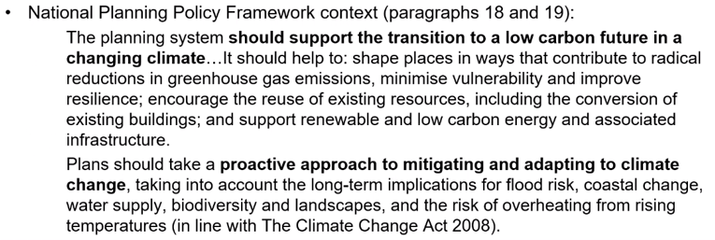
WCA 12th January
Local Plan is prioritising housing numbers over Climate Emergency and genuinely Sustainable Development
What National Planning Policy Framework (NPPF) says on Climate Change

Slide 18
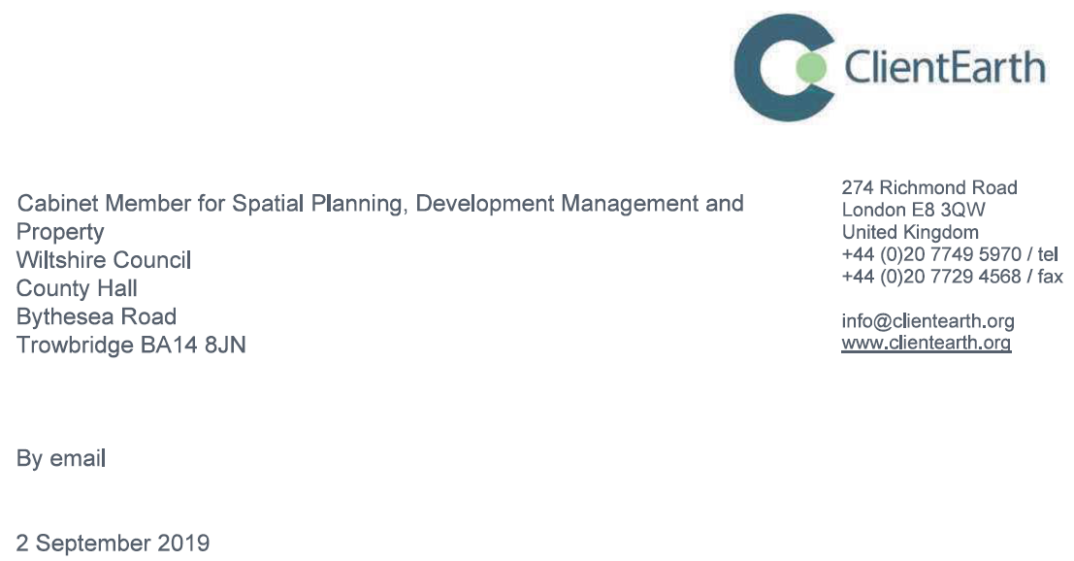
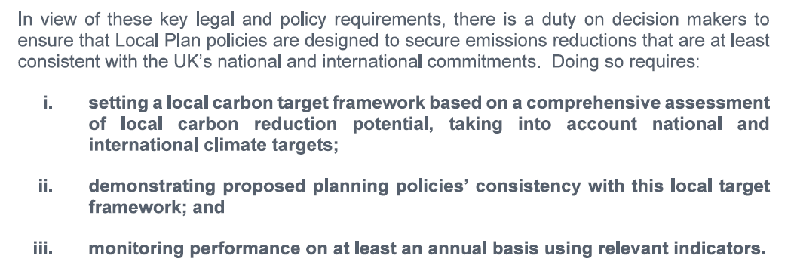
WCA 12th January
What Client Earth has said to Wiltshire Council
Wiltshire Council is not doing this…

Slide 19
WCA 12th January
Warm words, lack of substance
What the Local Plan Review says on Climate Change
Make best use of existing infrastructure;
Reduce the need to travel, and travel by the private car;
Maximise development that re-uses previously developed land;
Limiting the loss of countryside wherever possible;
Promoting sustainable transport and improving air quality;
Promoting renewable energy generation;
Develop evidence for new policies to tackle climate change.
How does that compare to the actual proposals?
Chippenham example: Preferred sites to East and South plus distributer road
Requires railway bridge and two river crossings plus new distributer road;
Obliterates the Bremhill Neighbourhood Plan and its green buffer;
Creates an out-of-town, car dependent, commuter extension;
All of it on locally distinctive countryside and high quality farmland;
Releasing carbon from the soil and trees;
Permanently removing existing carbon sinks;
Promoting emissions through long distance commuting & local congestion.

Slide 20
WCA 12th January
Some initial questions on the Local Plan
Why has Wiltshire Council taken on 5,000 more houses than the Govt. requested?
Has the Council calculated total carbon emissions associated with the Local Plan proposals and the different options?
How can building commuter town extensions help reduce carbon emissions?
Has the Council thought about a carbon reduction strategy for its Local Plan?
Has the Council developed a local carbon reduction framework that will enable its Local Plan to comply with the NPPF/ Climate Change Act and national targets?
How does its spatial strategy fit within this framework/ meet its targets?
How will the Local Plan take account of the Council’s own Climate Emergency Task Group recommendations?
Aren’t these proposals simply ‘business as usual’? (more roads, more commuters, more environmental destruction?)

Slide 21
WCA 12th January
Other plans/ strategies to consider
Executive response to Climate Emergency Task Group (on 13th Jan 21)
Won’t deliver net zero carbon via Stone Circle
Will only invest in renewable energy if ROI is better than alternatives
Approaching active travel investment via supplementary grant route (i.e. piecemeal rather than using Transport Budget)
Carbon implications of other Plans, policies and strategies to consider:
Local Transport Plan (LTP4)?
General reserves and other strategic investments?
Waste Strategy?
EV infrastructure strategy (absence of).

Slide 22
WCA Members meeting 6th January
Agenda
Welcome
News and events in January
MP Meetings
The Incinerator
Wiltshire Local Plan consultation
WC Full Council Meeting 23rd Feb 2021 (planning day of action)
Breakout session
Next Meeting and AGM
AOB

Slide 23
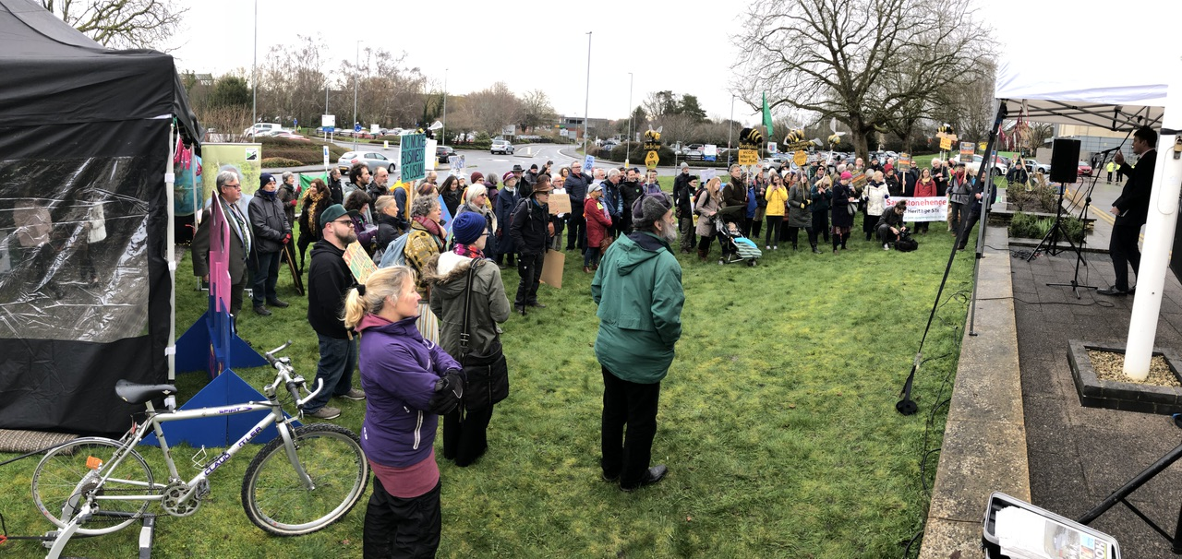
WCA Members meeting 6th January
WC Full Council Meeting – 23rd Feb 2021
Anniversary of acknowledgement of the climate emergency.

Slide 24
WCA Members meeting 6th January
2 Minute Break

Slide 25
WCA Members meeting 6th January
WC Full Council Meeting – 23rd Feb 2021
Break Out Session
Ideas to mark the anniversary
People to join a working group to plan

Slide 26
WCA Members meeting 6th January
Agenda
Welcome
News and events in January
MP Meetings
The Incinerator
Wiltshire Local Plan consultation
WC Full Council Meeting 23rd Feb 2021 (planning day of action)
Breakout session
Next Meeting and AGM
AOB

Slide 27
WCA Members meeting 6th January
Next Meeting - WCA AGM
WCA Annual General meeting GM – 30th January 2021 at 11.00
Election of Steering Group Members (Looking to expand)
Plans for the future of WCA
Update from Wiltshire Groups

Slide 28
WCA Members meeting 6th January
Agenda
Welcome
News and events in January
MP Meetings
The Incinerator
Wiltshire Local Plan consultation
WC Full Council Meeting 23rd Feb 2021 (Start planning day of action)
Breakout session
Next Meeting and AGM
AOB – Various talks and events

Slide 29
See you on the 30th January
Thank You Everybody

