Slide 1
WELCOME TO ‘Being greener’
Notes:
Good morning all, I’m Julie Strawson and I’m delighted to welcome you to the first Local Environment Action Friends Annual General Meeting. We will be recording the meeting so if you prefer to turn your cameras off please do.
You all have a copy of the agenda so I let’s proceed without delay!
Please may I ask you all to introduce yourselves.
Great now please may I ask you to mute your microphones.

Slide 2
Greener Gardening
Jonathan Plows

Slide 3
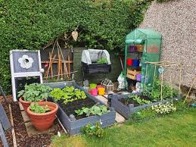
Welcome
Top tips to making your gardening even greener

Slide 4
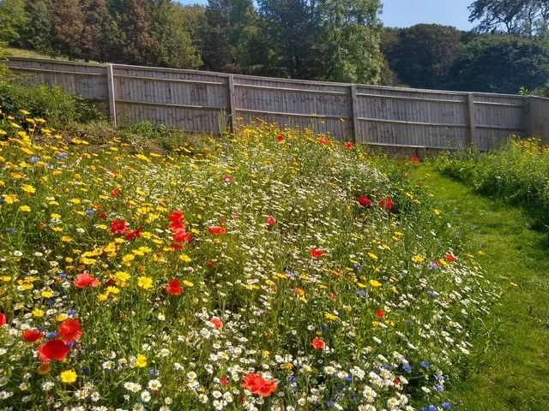
PLANT FOR POLLINATORS
The recent decline in the number of bees and other pollinating insects could have serious consequences for us all because so many food crops depend on them.
Easy Tip 1: choose plenty of bee-friendly plants,
Include varieties of different flower shapes to suit different feeding habits
some bees have very long tongues and love the tubular flowers of foxgloves,
other pollinators prefer the open flowers of echinacea and buddleia, for example.

Slide 5
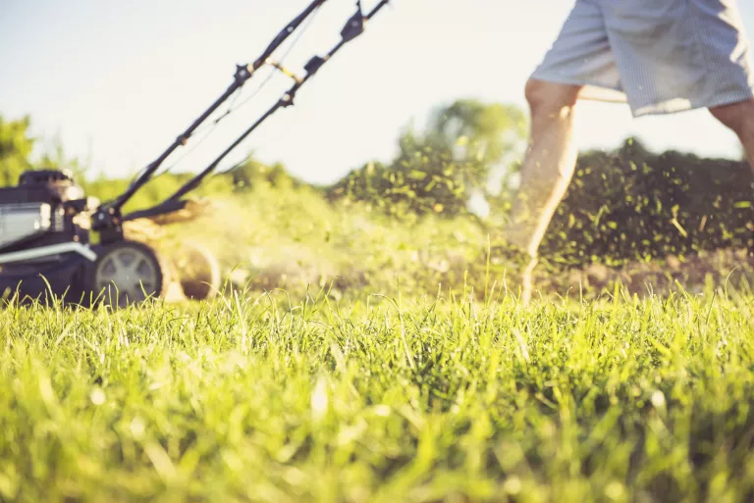
LEAVE YOUR LAWN
Easy Tip 2: To create an eco-friendly garden and attract pollinators to your plot is to leave some or all of your lawn to grow without mowing it until the end of the summer.
Easy Tip 3: Consider waiting longer than usual before getting out the mower
lawn weeds such as dandelions provide pollen early in the season while white clover is always a big hit with honeybees, and red clover is the flower of choice for bumblebees.
Easy Tip 4: When you do mow your lawn, try ‘grasscycling’ – leaving grass trimmings on the lawn after mowing to provide a natural fertilizer for the grass and help trap moisture in the soil.
Using the best lawn mower with a mulching facility is an easy way to do this

Slide 6
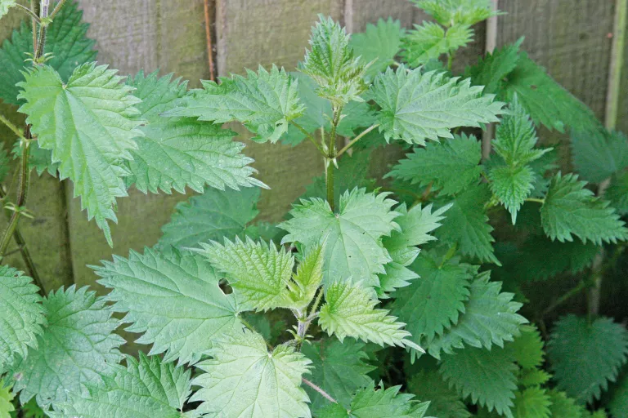
MAKE YOUR OWN FERTILISER
Easy Tip 5: Rather than buying expensive ready-made fertilizers, you can make your own plant-friendly nettle or comfrey tea cheaply and easily.
Grow a patch of comfrey or nettles specially for this purpose, or collect nettles locally.
Drop them into a bucket of water (one part leaves to ten parts water) then set them aside for a few days. The resulting liquid makes a wonderful plant food for free.
When nettles and comfrey are in flower, they will attract beneficial insects too (nettles, in particular are loved by small tortoiseshell and peacock butterflies whose larvae feed on the stems).

Slide 7
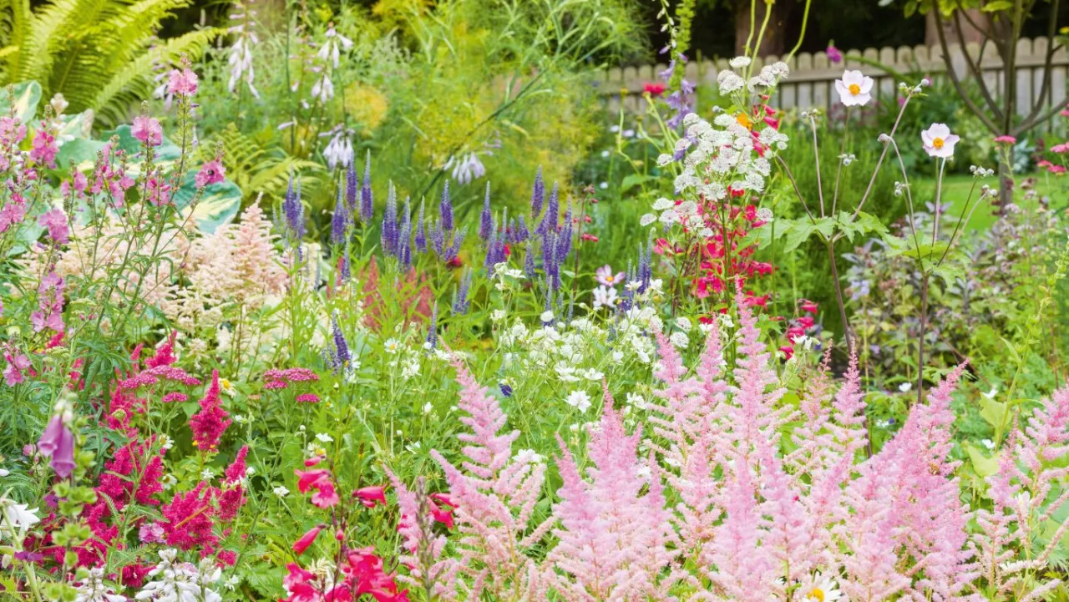
DITCH THE CHEMICALS
Easy Tip 6:
Greenfly can be dispatched from plants with a blast of water from a hose
Caterpillars can be picked off by hand (or, better still, cover the plants with garden fleece early in the season)
Slugs can be kept under control with small dishes of beer placed near vulnerable plants
encourage hedgehogs into your garden, you’ll soon find the slug population significantly decreases anyway.
Many common diseases such as blackspot on roses can be prevented by regularly spraying plants with an organic tonic – SB Plant Invigorator is a particularly good one to try.
Onions and chives grown around roses can help combat blackspot too.

Slide 8
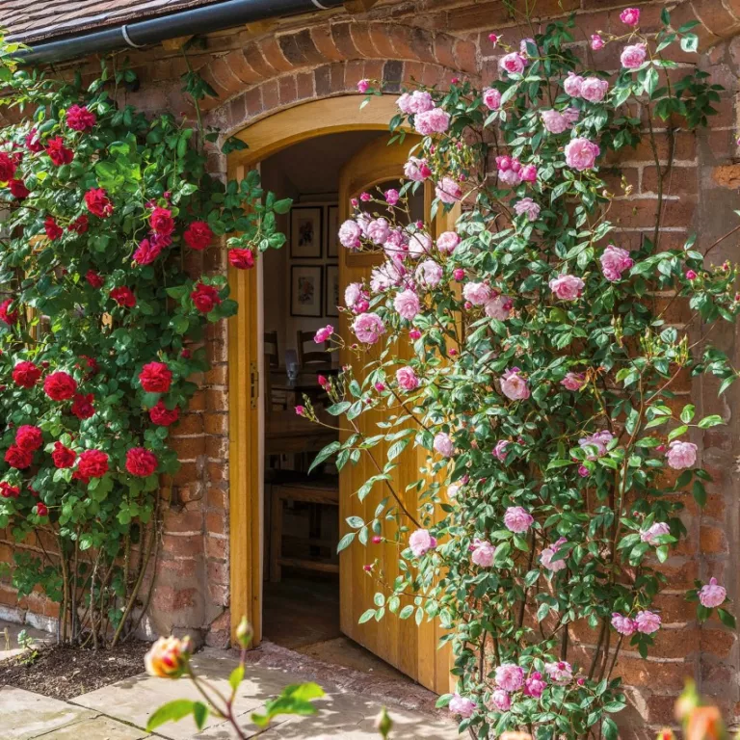
GREEN UP YOUR WALLS
Easy Tip 7:
Training the best climbing plants up the walls of your house doesn’t only look good, they also trap air, helping to insulate your home and potentially reduce your heating costs.
Climbers on a south-facing house wall will deflect heat from the sun and can even help to reduce the urban heat island effect in towns and cities.
Use climbers such as wisteria, or slower-growing wall shrubs – orange-, red- or yellow-berried pyracantha can look stunning.

Slide 9
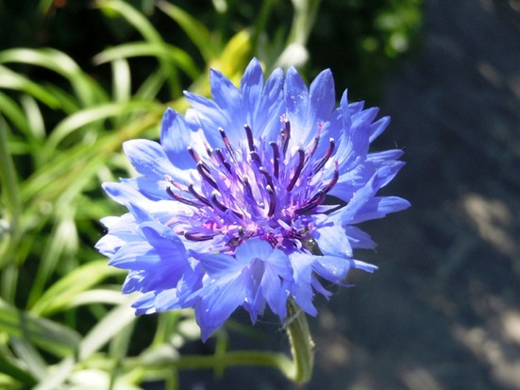
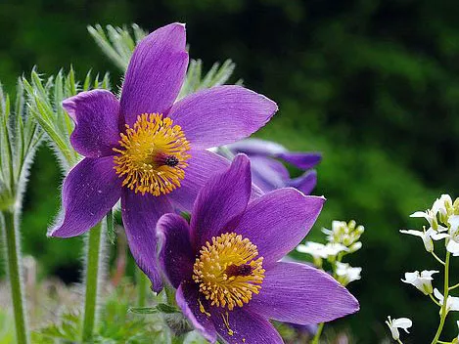
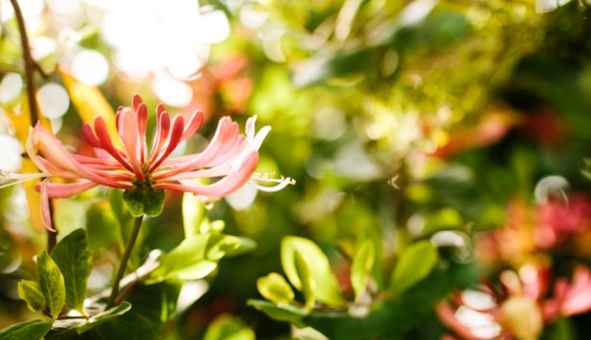
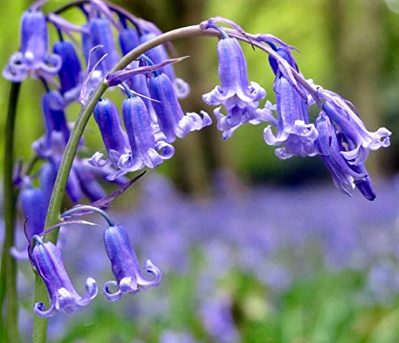
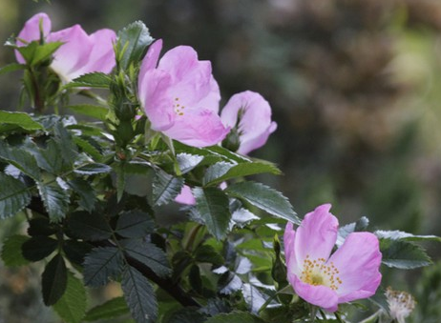
GO NATIVE
Easy Tip 8
Include native plants in your borders and attract wildlife to your space.
They are usually easy to grow and look after, and tend to be more resistant to pests and diseases than non-native varieties.

Slide 10
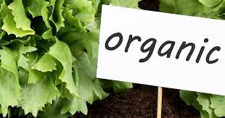
GO ORGANIC
WHAT IS MEANT BY ORGANIC GARDENING?
Organic gardening involves using less man-made, chemical substances, such as synthetic fertilisers and pesticides, but is also involves a more holistic approach to gardening.
Organic gardening requires an awareness of our wider impact on the environment, so gardening in a more environmentally-friendly way.

Slide 11
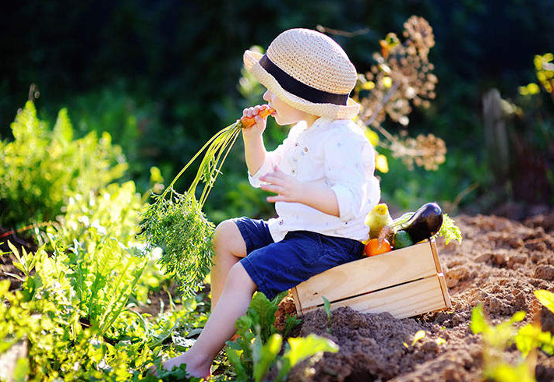
GO ORGANIC
By choosing organic products to feed and treat your plants, you'll be reducing the chance of inadvertently harming beneficial insects and you won’t be adding unnecessary chemicals to your soil either.
There are now organic versions of everything from slug controls to fertilizer and soil conditioner.

Slide 12
HOW TO CARE FOR PLANTS WHEN ORGANIC GARDENING
Top Tip 9:
Pay attention to what your plants need, including watering the roots not the foliage.
Regularly inspect the plants and stay vigilant so you catch pest and disease problems right away.
At the heart of organic gardening is to keep your growing area in good health, rather than just pest- and disease-free. A diverse and vigorous growing system, good hygiene, and close observation all help prevent problems.
You can suppress and control weeds naturally with a layer of bark mulch, composted straw or leaf mould, and removing any that pop up.
Physical barriers, such as netting or cages, are a good idea to protect your ripening crops.

Slide 13
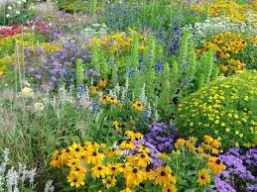
ENCOURAGE BIODIVERSITY FOR EASIER ORGANIC GARDENING
Easy Tip 10
Encourage a food chain balance to make wildlife work for you, from ladybirds eating greenfly to frogs devouring snails.
Brightly coloured flowers will attract a wide variety of insects, and the more bees you attract to the garden, the more pollination and larger yields you’ll have.

Slide 14
ENCOURAGE BIODIVERSITY FOR EASIER ORGANIC GARDENING
Easy Tip 11
Remember to rotate your crops as this prevents build-up of diseases in the soil.
Keep an eye on the watering; you don’t want your plants stressed as this makes them vulnerable to attack.
Certain crops help each other.
For example, plant a bed with sweetcorn, beans and squash together.
Each plant provides natural shelter and protection for the other.
The large leaves of the squash plants shade the sweetcorn’s roots from sunlight.
They also act as natural mulch by suppressing weeds and preventing moisture from evaporating from the soil’s surface.
The tall corn stems provide a sturdy support for beans to climb up. In turn, the beans fix nitrogen into the soil.

Slide 15
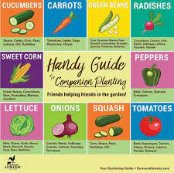
COMPANION PLANTING FOR AN ORGANIC FRUIT AND VEG PLOT
Easy Tip 12: Use companion planting to your organic vegetable garden’s advantage. Growing strongly scented plants beside your crops either confuses pests or attracts them away from your produce.
Basil – deters whitefly on tomatoes and kale.
Chives – deter aphids and carrot root fly.
French marigolds – deter aphids and whitefly, and attract hoverflies, whose larvae eat aphids; plant with tomatoes, aubergines and chillies.
Rosemary – deters carrot fly.
Sage – confuses pests of brassicas and deters carrot fly.
Nasturtium – sacrificial crop, lures aphids away from beans and attracts beneficial insects.
Dill – attracts hoverflies and wasps to eat aphids.
Mint and sage – repel slugs; plant with cabbages and lettuces.
Yarrow – attracts ladybirds and hoverflies.
Fennel – attracts hoverflies and ladybugs, which prey on aphids.
Lavender – attracts pollinators and deters aphids; plant with carrots and leeks.
Nettles – attract cabbage white butterflies, keeping them away from brassicas.

Slide 16
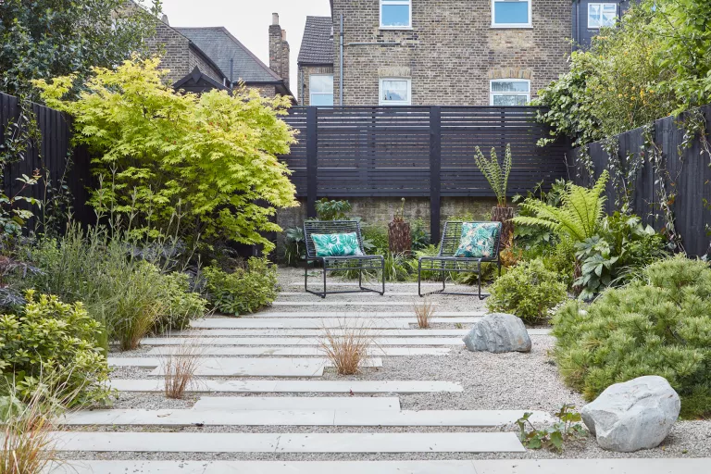
USE LOCAL MATERIALS
Easy Tip 13:
Purchase paving and bricks that haven’t travelled hundreds or even thousands of miles to get to your plot ~ this will help reduce your garden’s carbon footprint considerably – and support nearby businesses too.
Local materials also sit better in the landscape than if they’re brought in from elsewhere ~ your revamped garden will look more natural and established from the start.
When you’re buying timber products and decking in the UK, look for a Forest Stewardship Council (FSC) or Programme for the Endorsement of Forest Certification (PEFC) logo – that way, you can be sure the wood originates from certified plantations.
Ideally hard landscaping should be water permeable to help with slowing water run off. For example a drive could be gravel rather than solid paving.

Slide 17
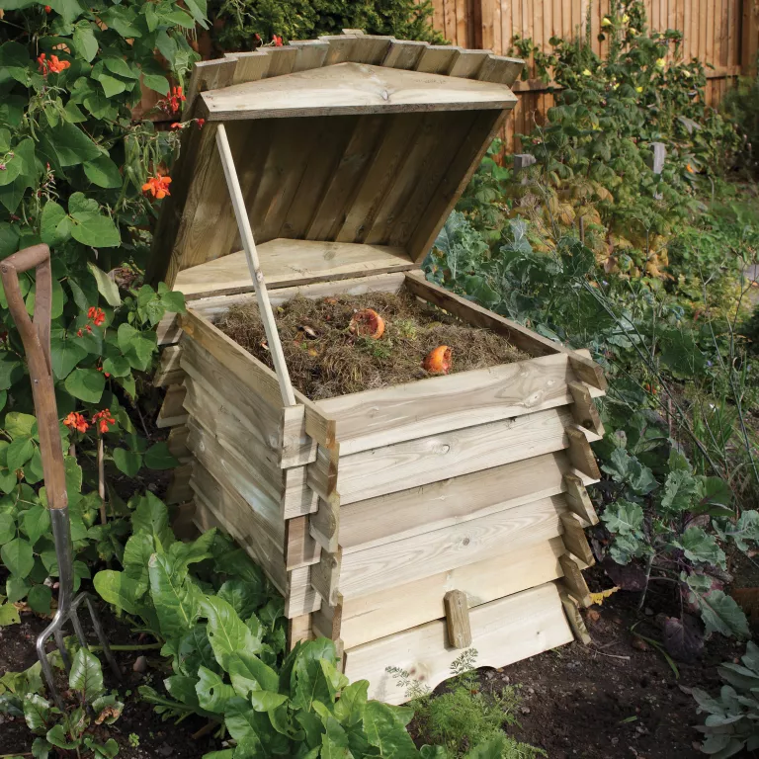
MAKE YOUR OWN COMPOST
Easy Tip 14:
There’s something incredibly satisfying about making your own compost from grass clippings and veg peelings that would otherwise go to waste, and it’s straightforward to do.

Slide 18
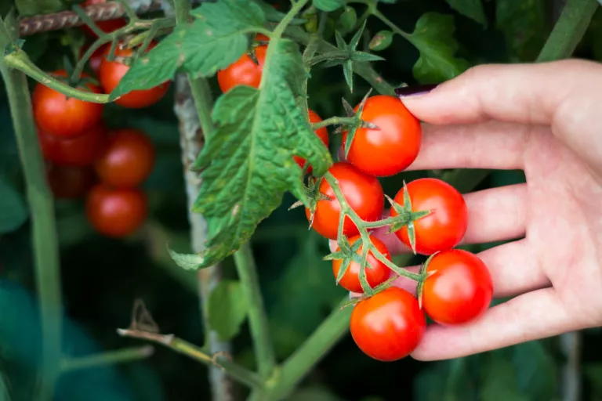
GROW YOUR OWN FOOD
Easy Tip 15:
If you want to reduce your environmental impact as well as cutting your supermarket bills, why not turn part of your garden into a veg patch and start growing your own fruit and vegetables?

Slide 19
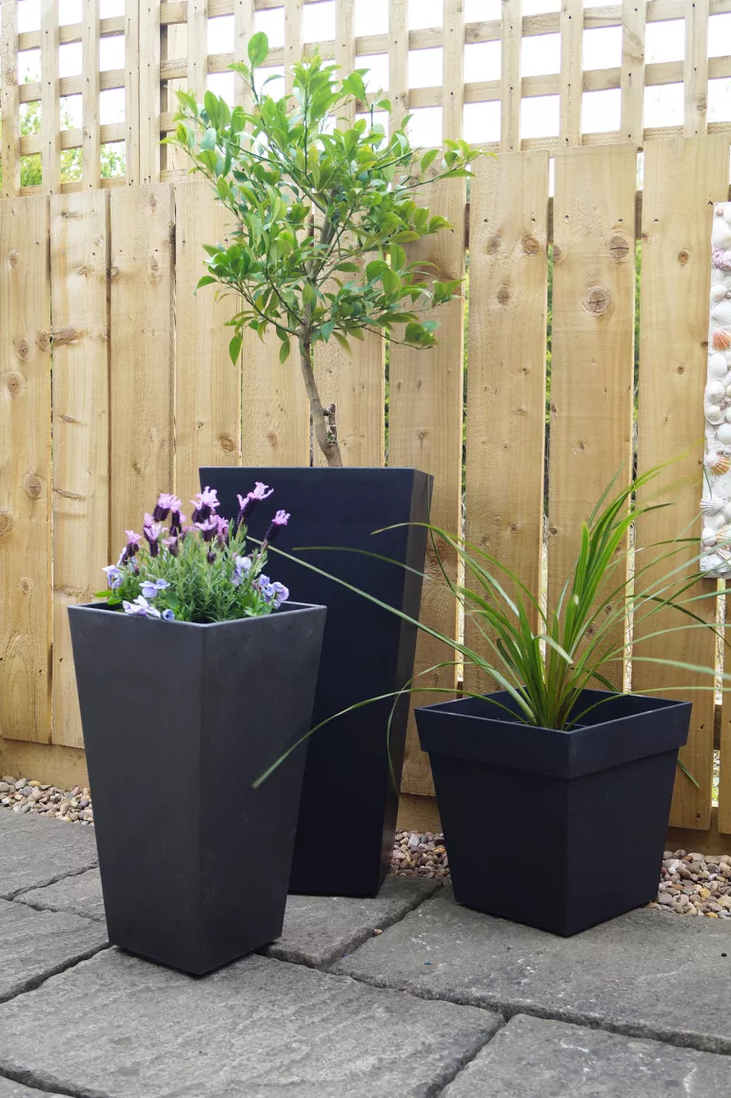
RECYCLE AND RE-USE
Easy Tip 16:
Avoid plastic pots
Some garden centres now offer a recycling service for plastic pots, but re-use any that you already have as many times as possible, for sowing seeds and growing on seedlings.
When you’re buying new plants, seek out one of the growing number of nurseries that will tip plants out of their plastic pots and wrap them in recycled paper for you to take home.
Instead of buying new pots for seed-sowing, use old egg boxes and the cardboard inner tube of loo rolls – they work brilliantly for this and will biodegrade if you plant them straight into the soil once the plants are big enough to go out.
Primeur’s ECO Garden range of stepping stones, borders, decking tiles and pots, for example, uses recycled rubber tyres. Apart from the fact that the tyres would otherwise take upwards of 80 years to decompose in landfill sites, the joy of using recycled rubber is that it’s non-slip, doesn’t crack or fade in hot weather, and is also lightweight.
Of course you don’t always have to buy new – a rummage around reclamation yards is a fun way of finding pre-loved garden accessories that you’re unlikely to see elsewhere.
Paving made from recycled concrete aggregate is now widely available too, and this can be a good option for your eco landscaping ideas.

Slide 20
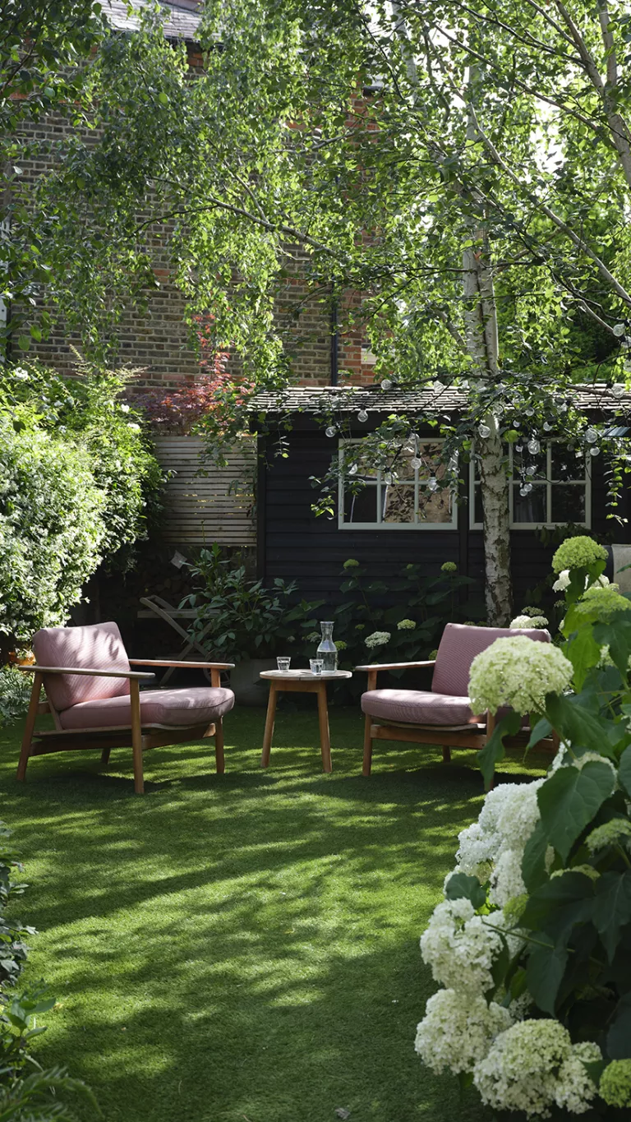
PLANT A TREE
Easy Tip 17:
According to recent research, gardens with trees are more attractive to wildlife than those without them, so adding some to your space is key if you want to learn how to create an eco friendly garden.
Even in the tiniest garden, there’s usually room to squeeze in a small tree - try a Japanese maple (Acer palmatum), a crab apple such as the upright ‘Golden Hornet’, or the diminutive Magnolia stellata, for example.
Some experts are predicting that in 30 years’ time the UK could have the same climate as the south of France. If that’s the case, a tree with a dense leaf canopy will be invaluable for providing shade, reducing the need for watering.

Slide 21
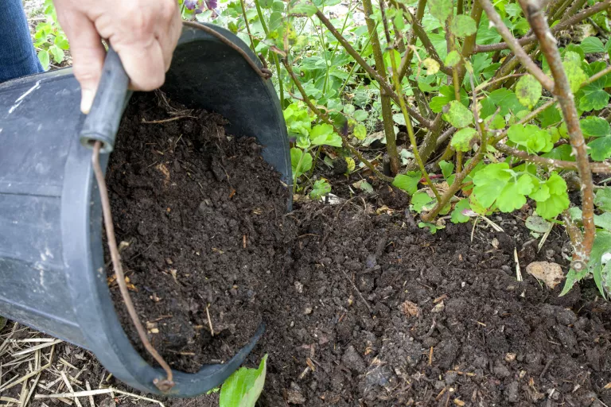
Go PEAT FREE
Easy Tip 18:
Peat has been a major component of potting compost for decades, but extracting it can destroy unique ecosystems that take centuries to form, causing irreparable damage to natural habitats, and as it forms very slowly, it isn’t sustainable.
Digging it up and spreading it around the garden also releases CO2 into the atmosphere.
There are now several good peat-free composts available.
To give plants an extra nutrient boost, it can be mixed with well-rotted manure.

Slide 22
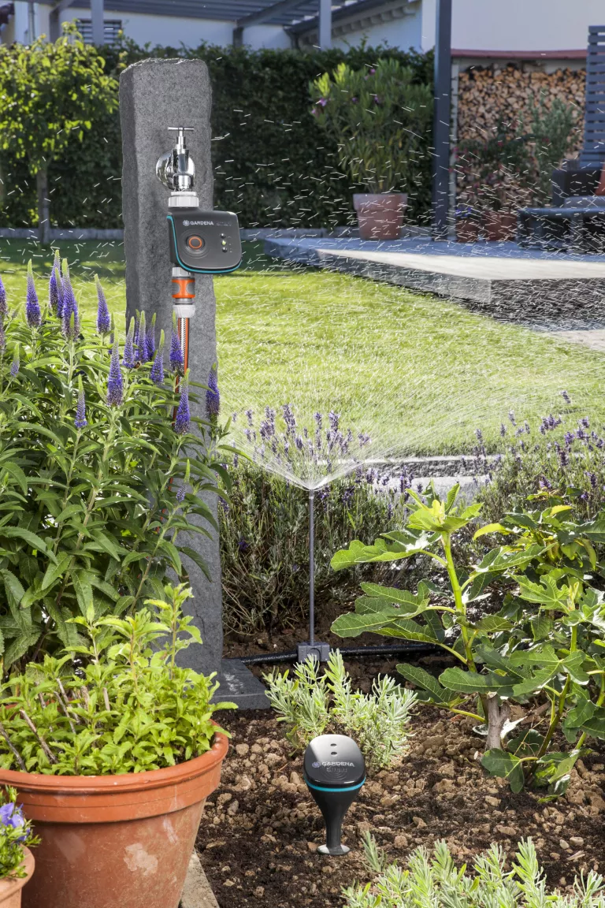
CONSERVE WATER
Easy Tip 19:
If you're serious about how to create an eco-friendly garden, rather than watering little and often, which encourages roots to stay near the surface where they will dry out more quickly, water very thoroughly once a week. This forces the roots to go down deeper and find moisture for themselves.
One watering can per plant per week should be enough – if you’re using a hose, count how many seconds it takes to fill a can and replicate that for each plant.
Applying a thick mulch of organic matter around the base of plants in spring will go along way to help lock in moisture too.

Slide 23
CONSERVE WATER
Easy Tip 20:
Plants in pots will need more regular watering, although water-retaining granules that you sprinkle into the potting compost will help keep it moist for longer.
The best solution is an automated watering system that ensures all plants – in pots, in borders and in the greenhouse – get water only when they need it.
One of the biggest water-wasting culprits in the garden is the lawn sprinkler. Instead, have the blades set higher in hot weather as this will stop the soil drying out so quickly and keep the grass greener for longer, meaning watering is not necessary.
When it rains, make sure you save every last drop by fitting a water butt on every downpipe.
If you have the space, you could even consider an underground rain tank. Larger ones can easily collect enough water for the average garden, and you can use them water to flush your WC too.

Slide 24
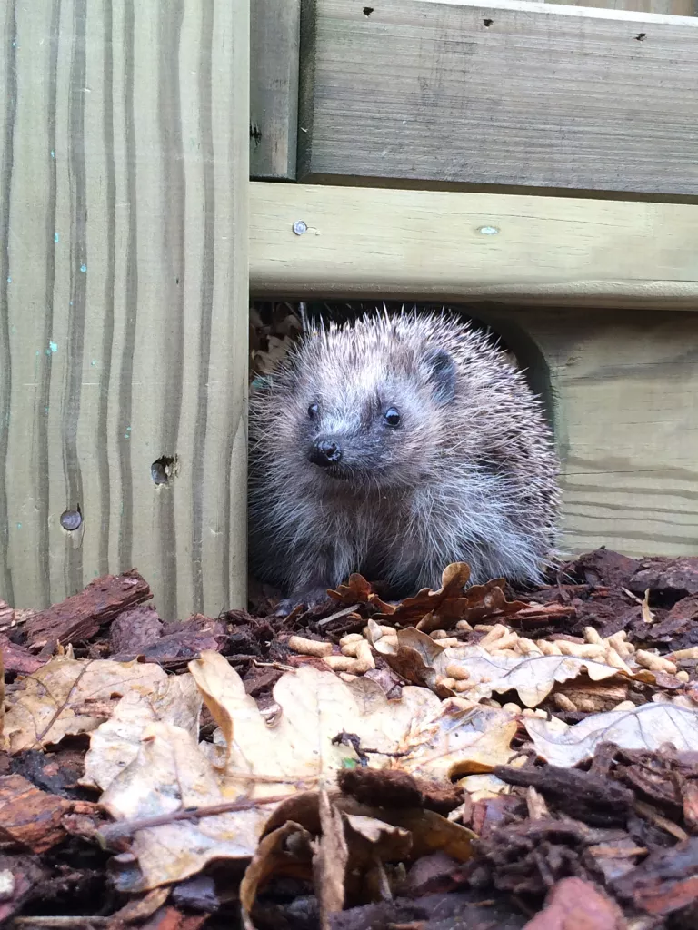
GIVE WILDLIFE A HOME
Easy Tip 21:
Leave a patch of nettles in a hidden corner, and don’t clear up all the wood after you’ve pruned a tree, for example.
Make a ‘Dead Hedge’, prunings and dry stems from your perennial plants can all be laired neatly in a hedge like shape.
Use upright posts to contain the materials and you have a fantastic environment for all sorts of wildlife. It will slowly decay leaving room for next years prunings.

Slide 25
GIVE WILDLIFE A HOME
Put up bird, bat boxes and bug hotels – this can be as simple as lengths of hollow garden canes tied together, making the perfect home for a number of different bee species.
There are some lovely hedgehog homes on the market now but if your garden perimeter has fences, the hogs won’t be able to get in.
A hedge is far more wildlife friendly in general than either a garden fence or a wall, offering nesting sites for birds and protection from predators to all sorts of small mammals.
If a fence or wall is the only option, clothe it with climbers – ivy, for example, is a rich source of nectar in autumn and winter when there’s little food around.
Build a small pond – in fact, even just water in a large pot or half barrel will yield results.

Slide 26
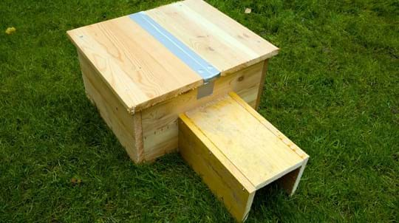

Slide 27
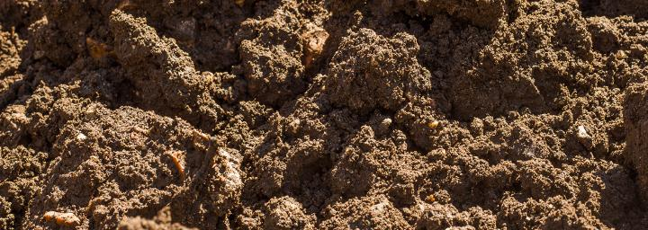
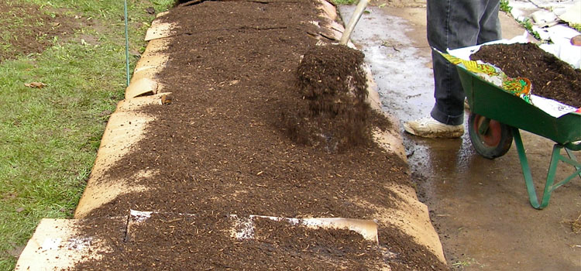
The No-Dig Method
Easy Tip 22:
No Dig is an attractive way of growing.
It provides a rich soil to grow in, and it's an excellent way to clear a weed-infested growing area.
In principle, by avoiding digging you will not be disrupting the soil life. This is the important micro-organisms, fungi and worms, that help feed plant roots.
You will need a large quantity of organic matter.
You can use home-made compost, leafmould, well-rotted manure, green waste compost or even bagged peat-free compost.

Slide 28
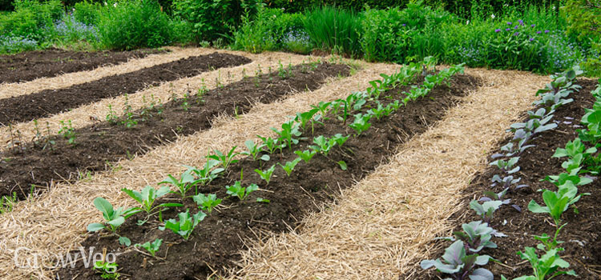
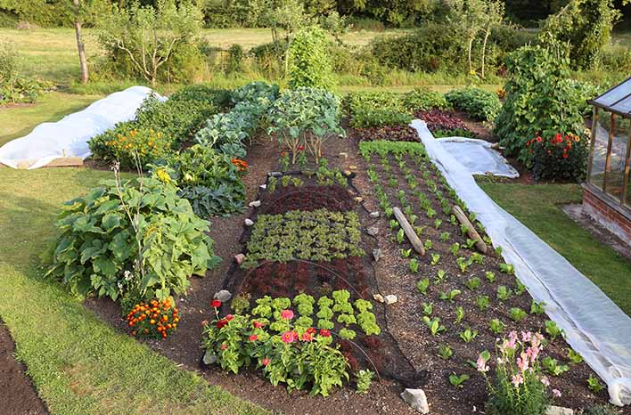
The No-Dig Method
To clear a growing area of weeds you will need:
Plenty of organic matter
A sheet of light-excluding material, such as cardboard
The aim is simple - to exclude the light so weeds can't grow. And to cover the soil with a rich organic mulch.
First slash down tall weed foliage to ground level. Put it on the compost heap.
Lay sheets of light-excluding material (cardboard etc) so the ground is completely covered.
Now put a deep layer of organic mulch. Use homemade compost, fully-rotted manure, leaves, straw, grass mowings – or even a mix of them all, so long as it is more than 15 - 20 cms thick.
Tread it down firmly. Eventually it will rot down and create a wonderful, friable soil texture which is not only rich but allows weed roots, such as bindweed, to be pulled out easily.
If you use a horticultural membrane such as mypex, you can put the mulch under, not over, it. Either way, make sure that no light can penetrate down into the soil.
In both instances, wait for 6 months at least for the weeds to die down and the soil organisms to do their work. Be patient! It can take up to a year to completely weaken the weeds, especially those with deep and extensive roots like bindweed, dock and bramble. The soil has become so rich and friable that you will be able to pull roots out easily.

Slide 29
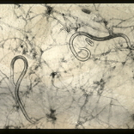
Nematodes
Easy Tip 23
Nematodes kill pests such as slugs, vine weevil and ants – without using harmful toxic chemicals.
What are they?
Nematodes are microscopic creatures, that act as parasites on other insects. They release bacteria into the host’s body to kill them. The nematode then eats the host.
For the organic grower, this is a biological - not chemical - pest control. Unlike a chemical spray, which may drift off target, nematodes are specific to the host pest, so that other wildlife is not affected.
You can buy nematodes online. However, they aren't necessarily cheap and you do need to follow the very precise instructions on how to use them.

Slide 30
Importing and exporting plants
Easy Tip 24:
Plant health is increasingly under threat. Climate change and human activities have altered ecosystems, reducing biodiversity and creating new niches where pests and diseases can thrive.
At the same time, international travel and trade has tripled in volume in the last decade and can quickly spread pests and diseases around the world causing great damage to horticulture, crops and the environment.
There are statutory controls on importing plants and plant products into the UK to safeguard plant health.
https://www.rhs.org.uk/prevention-protection/importing-and-exporting-plants

Slide 31
Importing and exporting plants
Quick facts
Importing plants poses potential risks of introducing new pests and diseases
There are new restrictions on importing plants into the UK from the EU
Plant material arriving into GB from the EU must now have a phytosanitary certificate
The UK has a new UK plant passport system
If in doubt, contact the Animal and Plant Health Agency
https://www.rhs.org.uk/prevention-protection/importing-and-exporting-plants

Slide 32
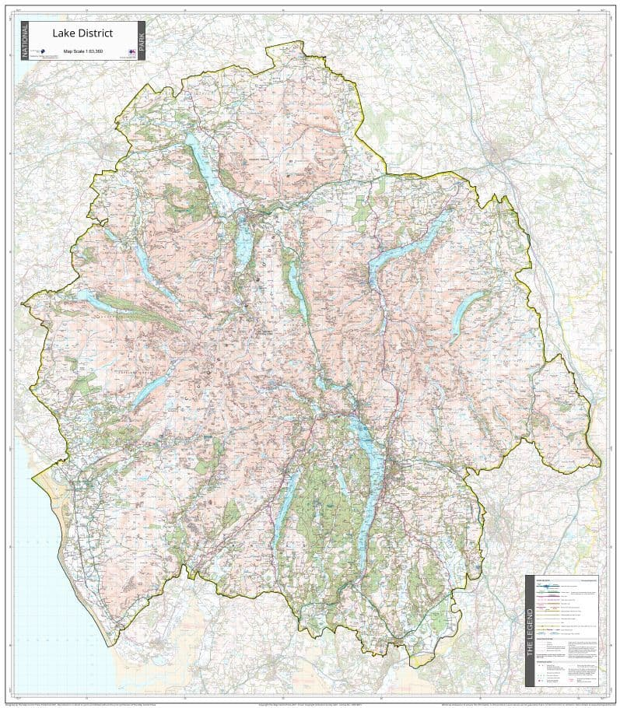
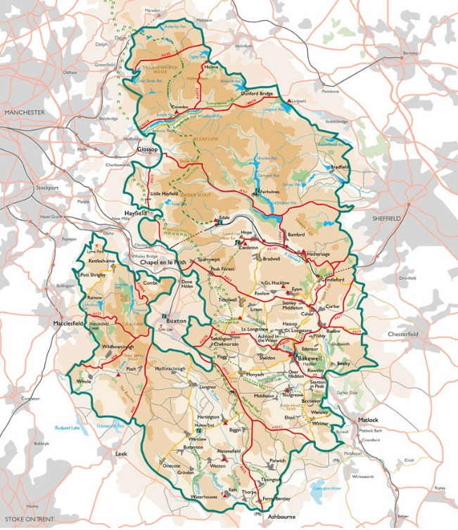
Below is an interesting quote from the Woodland Trust
'Did you know the UK’s gardens cover a combined landmass that’s bigger than the Lake District and Peak District put together?
That’s a huge area and means gardens can provide vital space for wildlife in a human-dominated landscape.’
+
=
930,627 acres

Slide 33
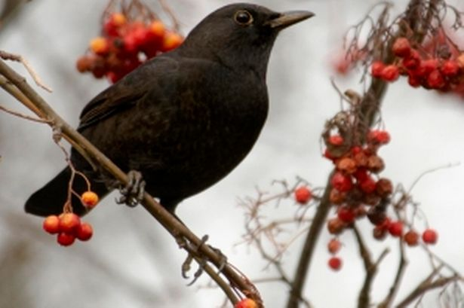
Delay cutting hedges to help garden birds
The Royal Society for the Protection of Birds (RSPB) says that giving hedges, trees and bushes a ‘short back and sides’ in September is bad news for birds, as many plants will still have an abundance of berries or insects which could see the birds through the winter.
You could also disturb late nesting birds as you cut back greenery as they may still be resident in shrubs and hedges.
Most garden birds breed between March and August but some species like collared doves and pigeons will be on their nests until late into September.
Adrian Thomas, author of the RSPB book Gardening for Wildlife, said: “Many hedges, bushes and trees will be harbouring insects and their eggs throughout the winter, or will bear all kinds of fruit. These can mean the difference between life and death for many resident birds and winter visitors.
“Even some berries like Firethorn, which are less popular with the birds, will be used as late as February, once the more sought-after berries have already been taken
“If you can wait until late winter to do the pruning, when plants are dormant anyway, you can give your garden wildlife the best chance at making the most of all that good food before things start coming to life again in the spring.
“It’s always possible that you’ll find a little face staring back at you when you chop back the leaves, because some late-nesting bird is bringing up its chicks there. It is extremely distressing for both the bird and the gardener when a potential nest or shelter is disturbed.”
Also delay cutting your perennial plants until late February or March to give a home to insects thought the worst of the winter and provide some extra seed for birds and animals.

Slide 34
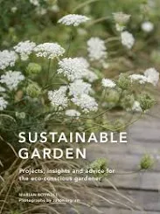
Marian Boswall
An award winning garden designer Marian Boswall has a book out called 'Sustainable Garden: Projects, insights and advice for the eco-conscious gardener’.
She talks of changing our mindset ~ surely vital and it's interesting that she is known for designing large smart gardens and is talking about relaxing the way we think about gardening.

