Slide 1
WCA/ WC/ John Glen MP

Slide 2
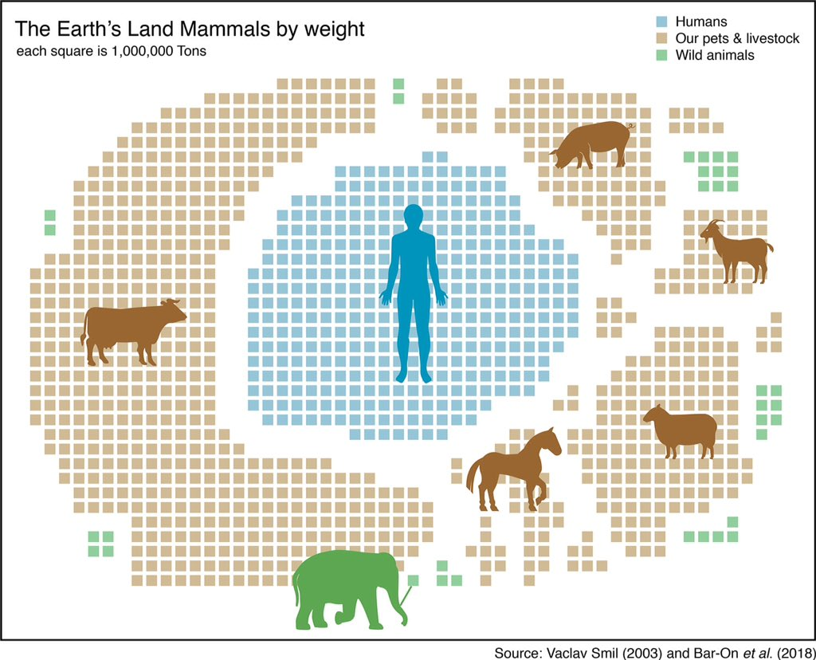

Slide 3
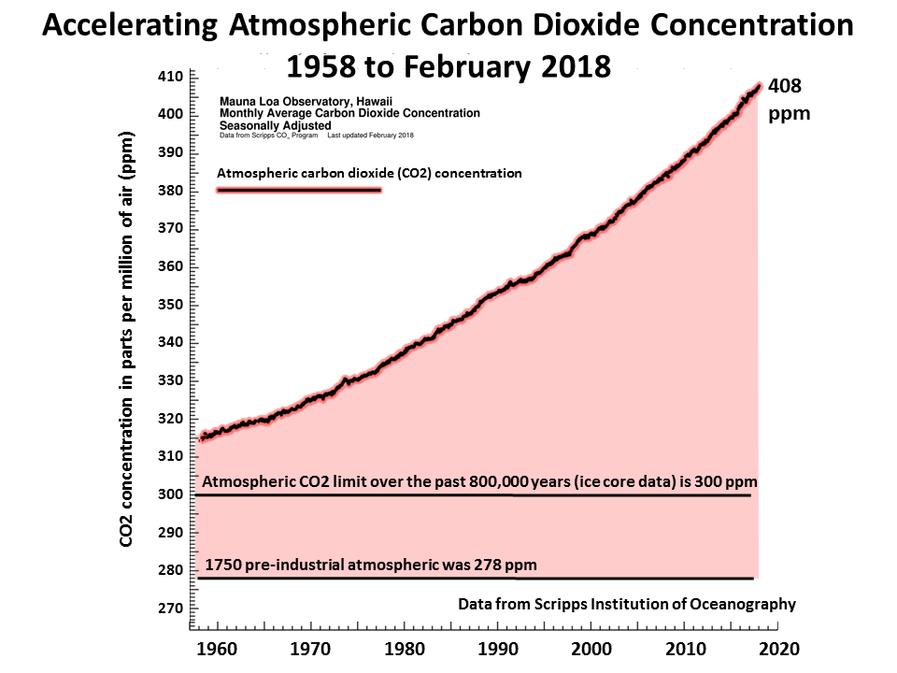
NONE OF THIS HAS WORKED
2018: COP24
2015: Paris Agreement
2006: Stern Report
2001: US Renounces Kyoto
1997: Kyoto Protocol
1992 Rio Treaty
1990: First IPCC

Slide 4
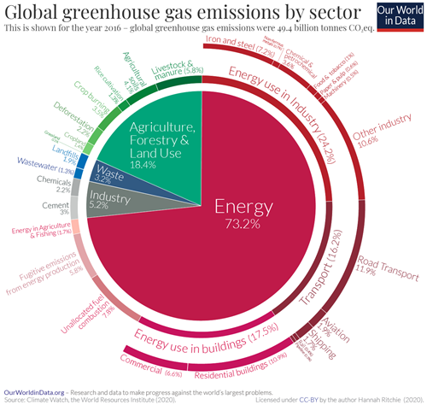
Note: green bit, mostly methane is much bigger proportion of current heating effect: figures use GWP100, ie amortised over 100 years, and CO2 lasts longer so looks bigger on the chart.

Slide 5
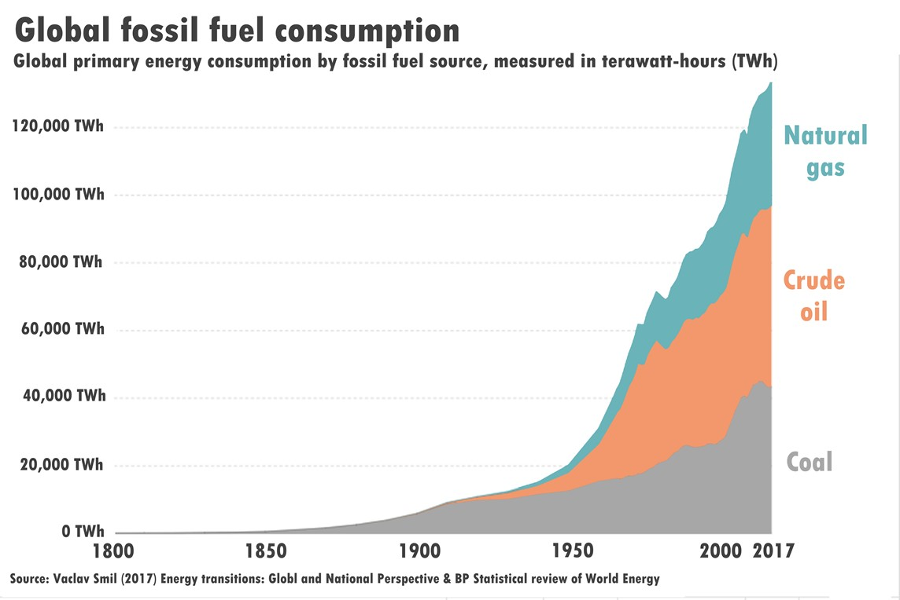
FOSSIL FUEL USE CONTINUES TO SKYROCKET

Slide 6
WHY HASN’T IT WORKED?
Structural problems
Short-termism of democracy
We need a long term plan
Need for action to be collective (locally and globally)
Notes:
“Democracy is the worst form of government, except for all the others.”
― Winston S. Churchill
[From transcript] “So why not? Well… the reason is that there are some fundamental structural problems with how we run society that are getting in the way of being able to make headway on this problem.
One, paradoxically, is democracy. Although we think that democracy – at least we in the democratic world think that democracy – is the fairest form of government, it has a fatal flaw which is that every few years the government goes back to the people and says “Will you vote us back in or not?” and that means that in order to win votes they need to please people in the here-and-now. So if a government is to say to the people “We’re going to do something that’s going to cause a great deal of economic pain, for the next ten years or twenty years” then they won’t be voted back in. And they know that. And so their hands are tied with what they are able to do.
The second problem is capitalism. Capitalism is the way in which we manage to make society work – we manage to have billions of humans who are basically strangers to each other interact in a peaceful and productive and economically viable manner. So capitalism has been a wonderful thing in many ways. But it has a fatal flaw, which is that it doesn’t “cost” the future – it doesn’t look at the future and say “What is that future worth to me, right now?” So we can trade in concrete things – we can trade in oil, we can trade in gold, we can trade in crops – we can’t trade in our grandchildren’s futures. It’s really hard to put a price on that.
And then finally, the problem is that what we need to do to stop carbon emissions is for every single human to take action – but this will only work if we all do it. It doesn’t make sense for one person or a few people to do it. And every human knows that. Everybody knows: “I could walk to work – it means that I’ going to get to work half an hour later, and I know it’s not going to make any difference unless eveybody’s walking to work, and I look around me and everyone else is driving, so I’m going to drive. I wish I didn’t have to but… what else can I do?” “I need to go to this conference. The only way to get there is to fly. Our aeroplanes all have carbon-emitting fuels. I wish they didn’t but they do – nobody’s done anything about that…” So the problem is that despite what we may think as individuals, we are trapped in this fact that unless everybody works together, individual action is pointless.”

Slide 7
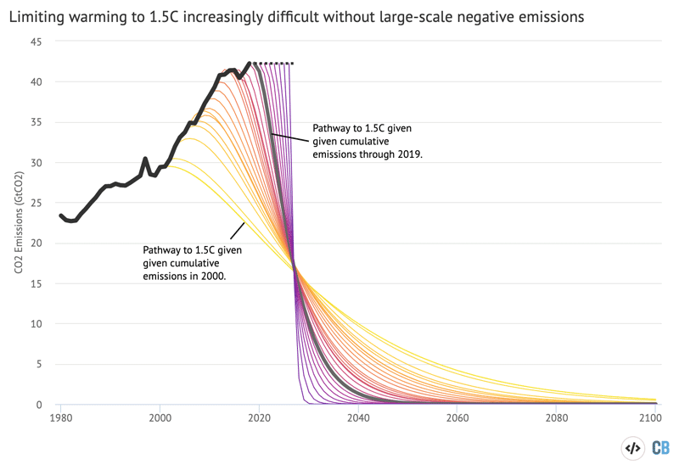
Pathways to 1.5C without negative emissions get harder every year we delay
https://www.carbonbrief.org/unep-1-5c-climate-target-slipping-out-of-reach

