Slide 1
Wiltshire
Climate
Alliance
Max S. Longley
Network Development Manager
22.07.2021

Slide 2
Network Development Manager
South Central Region: Hampshire, Isle of Wight, Wiltshire and Dorset
1. Contracted support to local authorities/developers/contractors/organisations.
Network planning: feasibility studies
Design
Land ownership
Planning
2. Business development, NCN enquiries/issues, community engagement, volunteer support, NCN promotion…
Minster Street| 22 July 2021

Slide 3
Setting the Context
Department for Transport Gear Change: A bold vision for cycling and walking
Four themes:
1. Better streets for everyone
2. Active travel at the heart of decision-making
3. Empowering and encouraging Local Authorities
4. Enabling people to cycle and walk and protecting them when they do
Minster Street| 22 July 2021

Slide 4
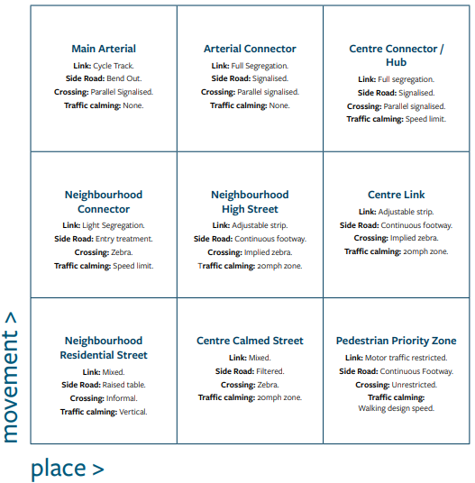
New Design Standards
Document title | 22 July 2021

Slide 5
NCN Design Principles
1. Be traffic-free or a quiet-way
2. Be wide enough to comfortably accommodate all users.
3. Be designed to minimise maintenance.
4. Be signed and clearly and consistently
5. Have a smooth surface that is well drained
Document title | 22 July 2021

Slide 6
NCN Design Principles
6. Be fully accessible to all legitimate users
7. Feel like a safe place to be.
8. Enable all users to cross roads safely and step-free.
9. Be attractive and interesting.
Document title | 22 July 2021

Slide 7
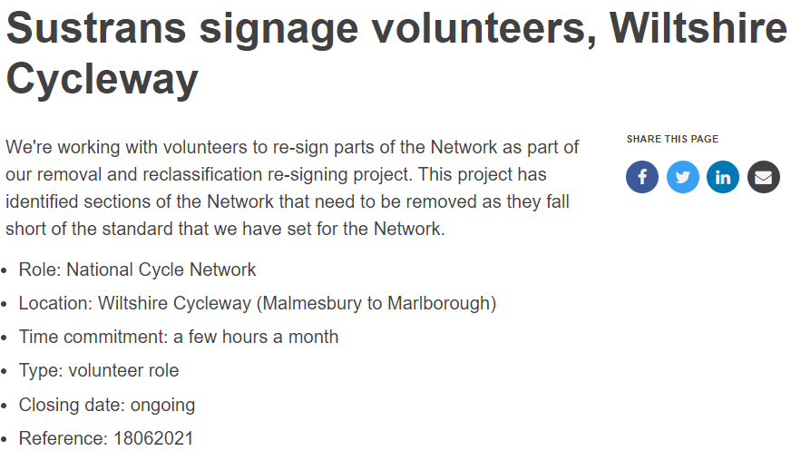
Getting Involved
Document title | 22 July 2021

