Slide 1
Images and media showing what can be moved by bike
Please add any images, videos, screenshots, links etc to this presentation to illustrate what is possible.
Whenever you can, please provide original source references

Slide 2
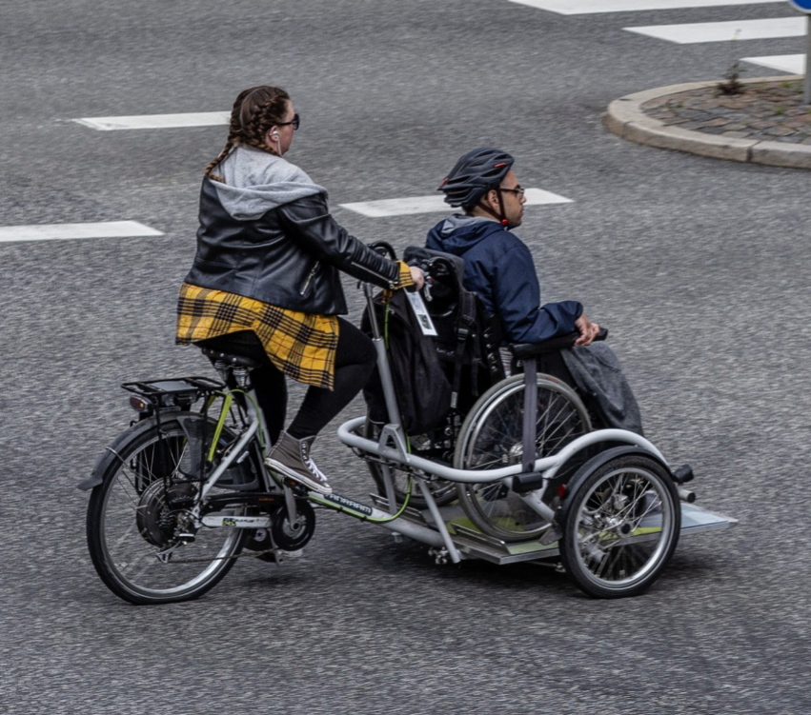

Slide 3
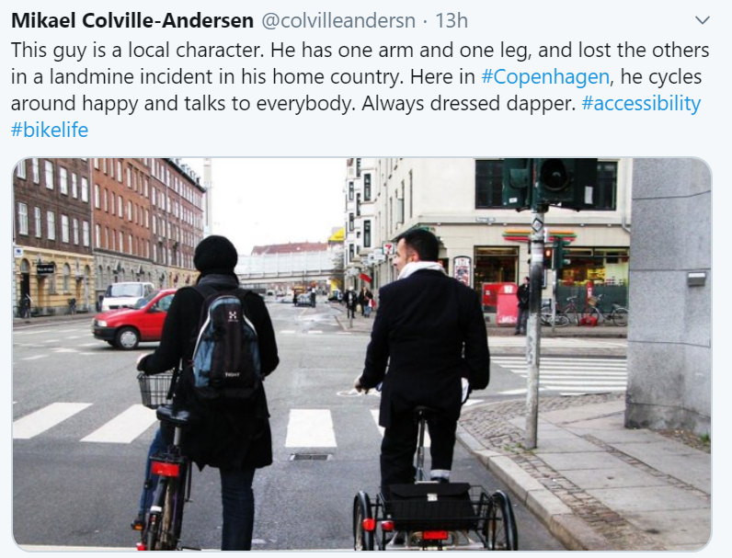

Slide 4
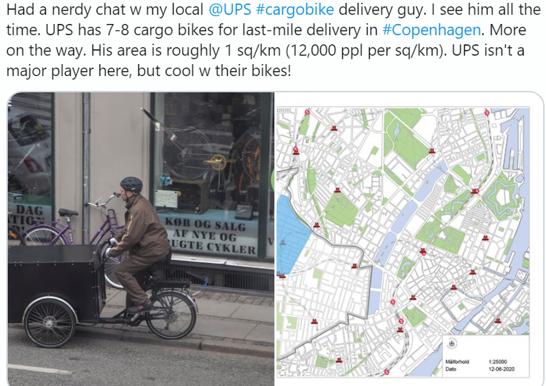
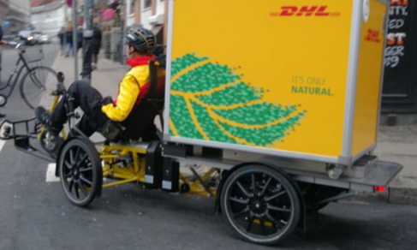

Slide 5
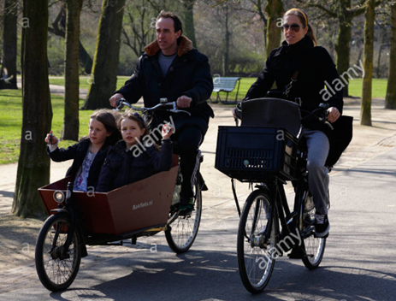
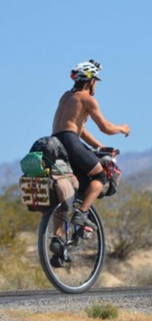

Slide 6
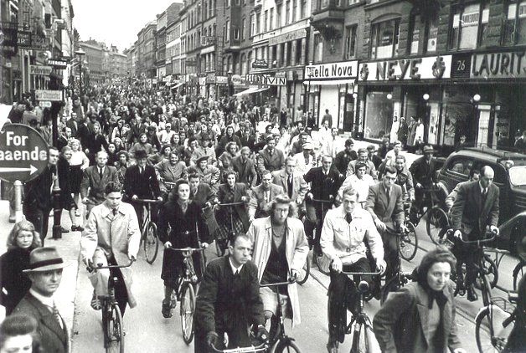
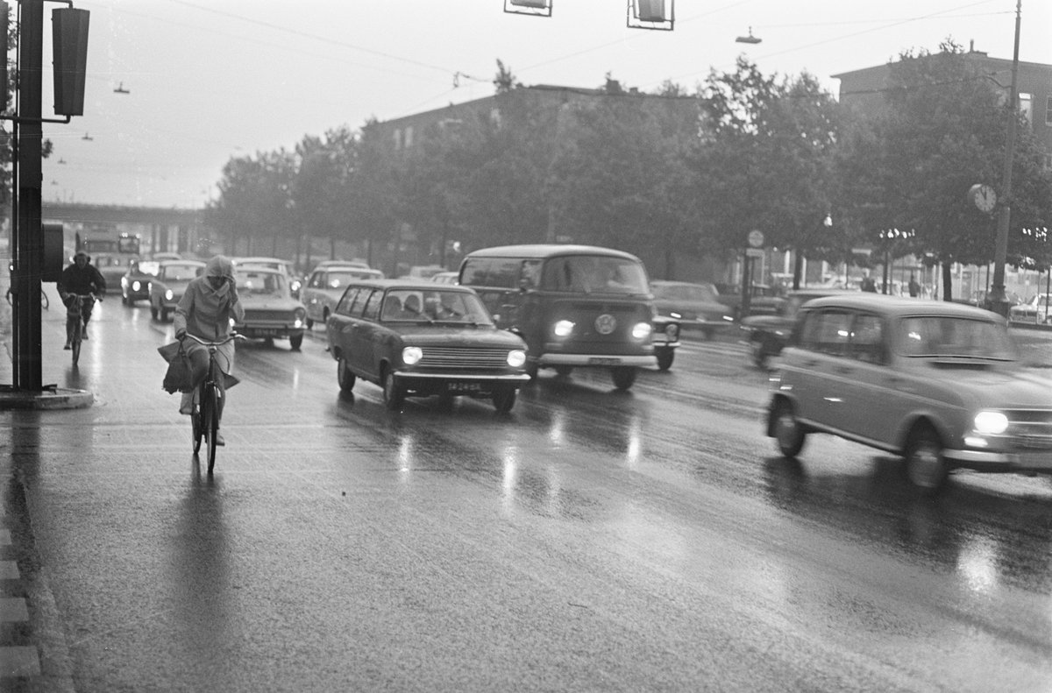
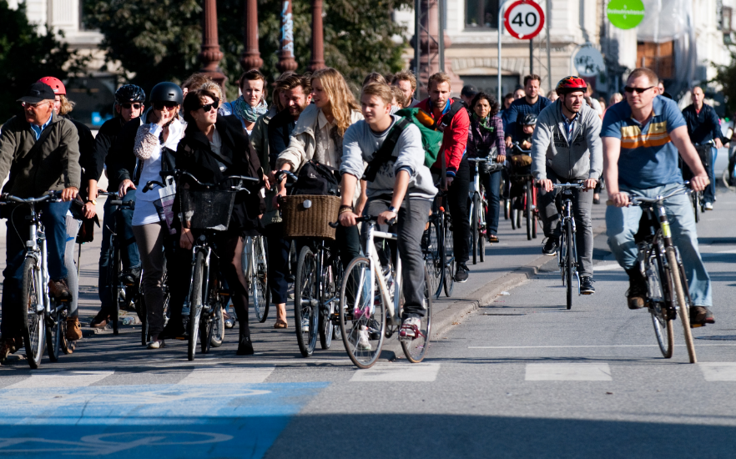
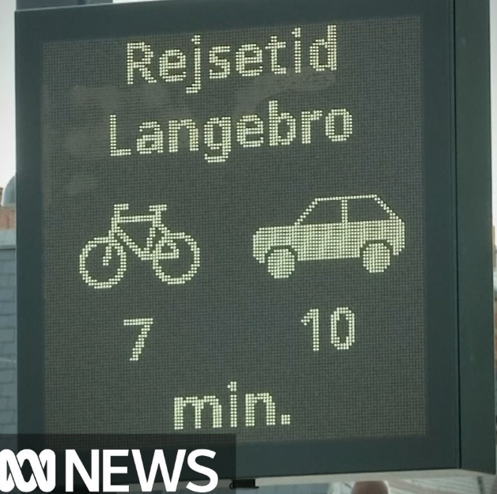
Copenhagen’s transport story
1940
Citizens demonstrated and campaigned after city became car focused in 1950’s and 1960’s
City government changed policy, started to invest in public transport and cycling infrastructure
People were given information and evidence of benefits of public transport, cycling and walking
City planning pioneers nudged people
taking away 3 parking spaces on each street each year
syncing traffic lights to speed of cyclists (‘Greenwave’ so green all the time if cycle at 20kph – 12mph)
Introduced signs that show travel times by mode
Introduced cycling infrastructure, bike parking etc.
Most people chose to change as quicker, safer, healthier (and environment improvement)
1960
Today
See also https://www.theguardian.com/cities/gallery/2018/jun/11/copenhagenize-case-urban-cycling-graphs
Notes:
Netherlands, population 17 million, 27% OF ALL DAILY TRIPS ARE BY BICYCLE

Slide 7
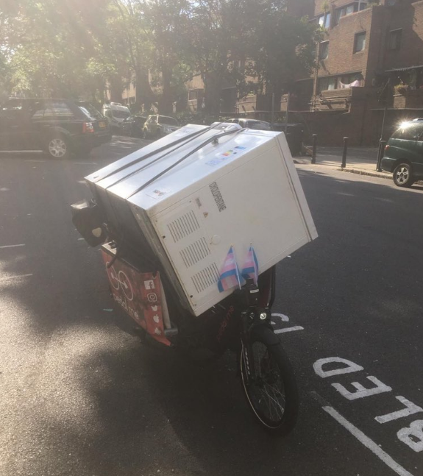
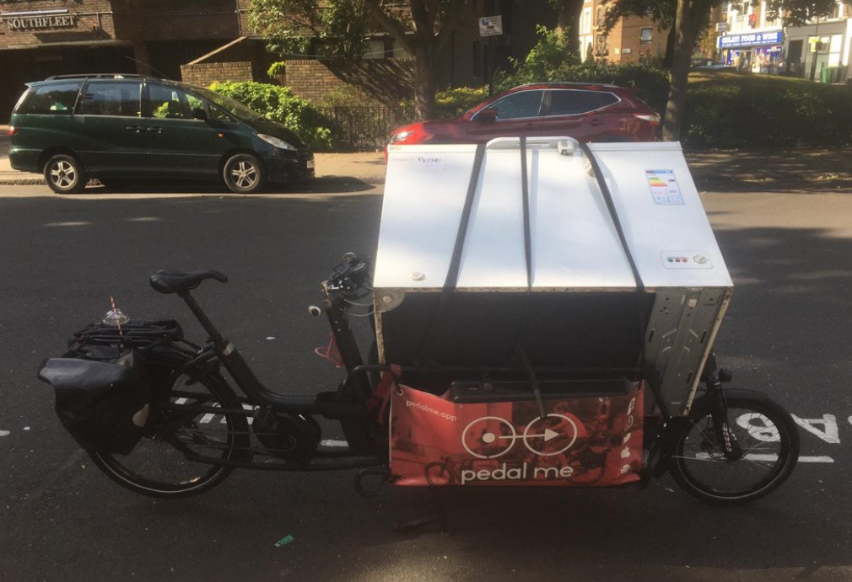
Chest Freezer on a bike – yes we can do that
https://twitter.com/search?q=chest%20freezer%20on%20a%20bike%20yes%20you%20can&src=typed_query

Slide 8
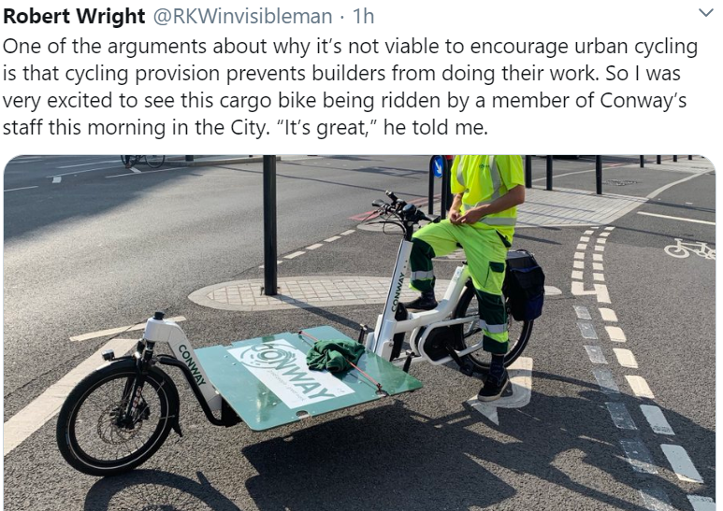
This is one of a number bought by a major building contractor in London

Slide 9
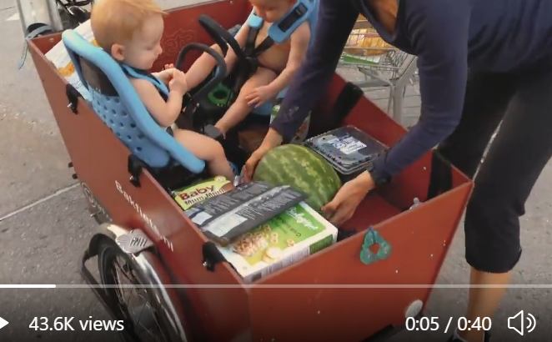
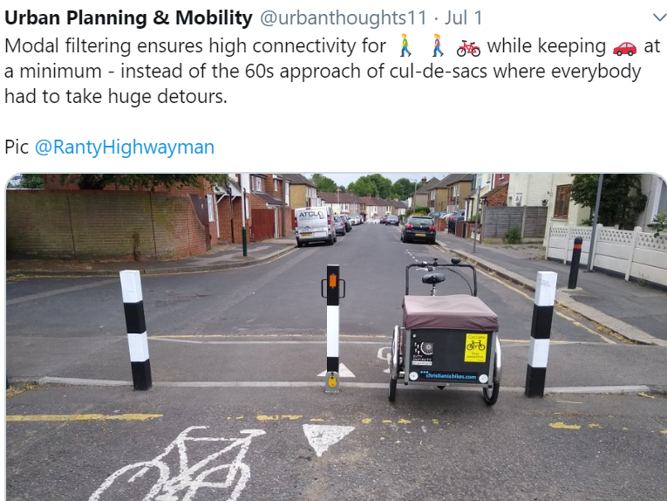
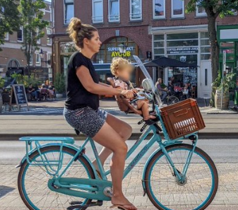
https://twitter.com/i/status/1300149407317401606

Slide 10
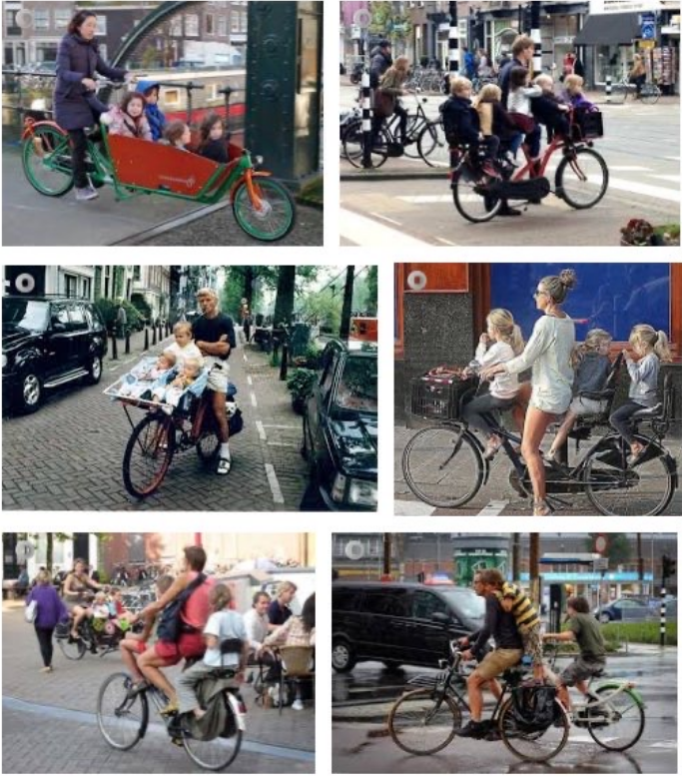
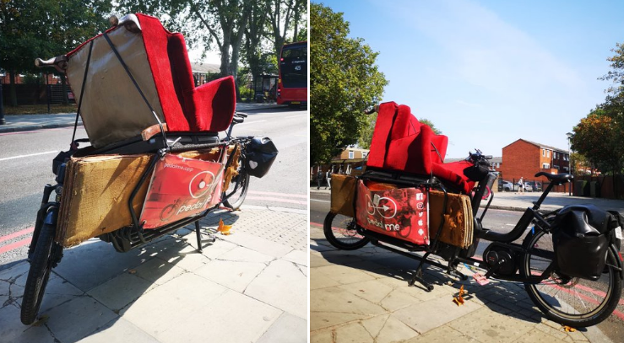
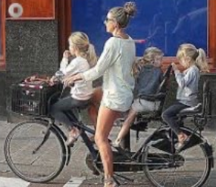

Slide 11
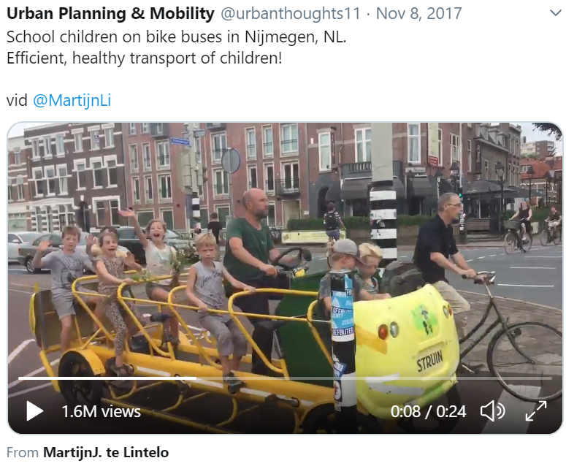
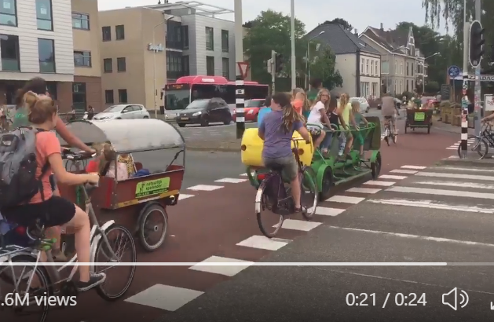
https://twitter.com/i/status/928339763870003201

Slide 12
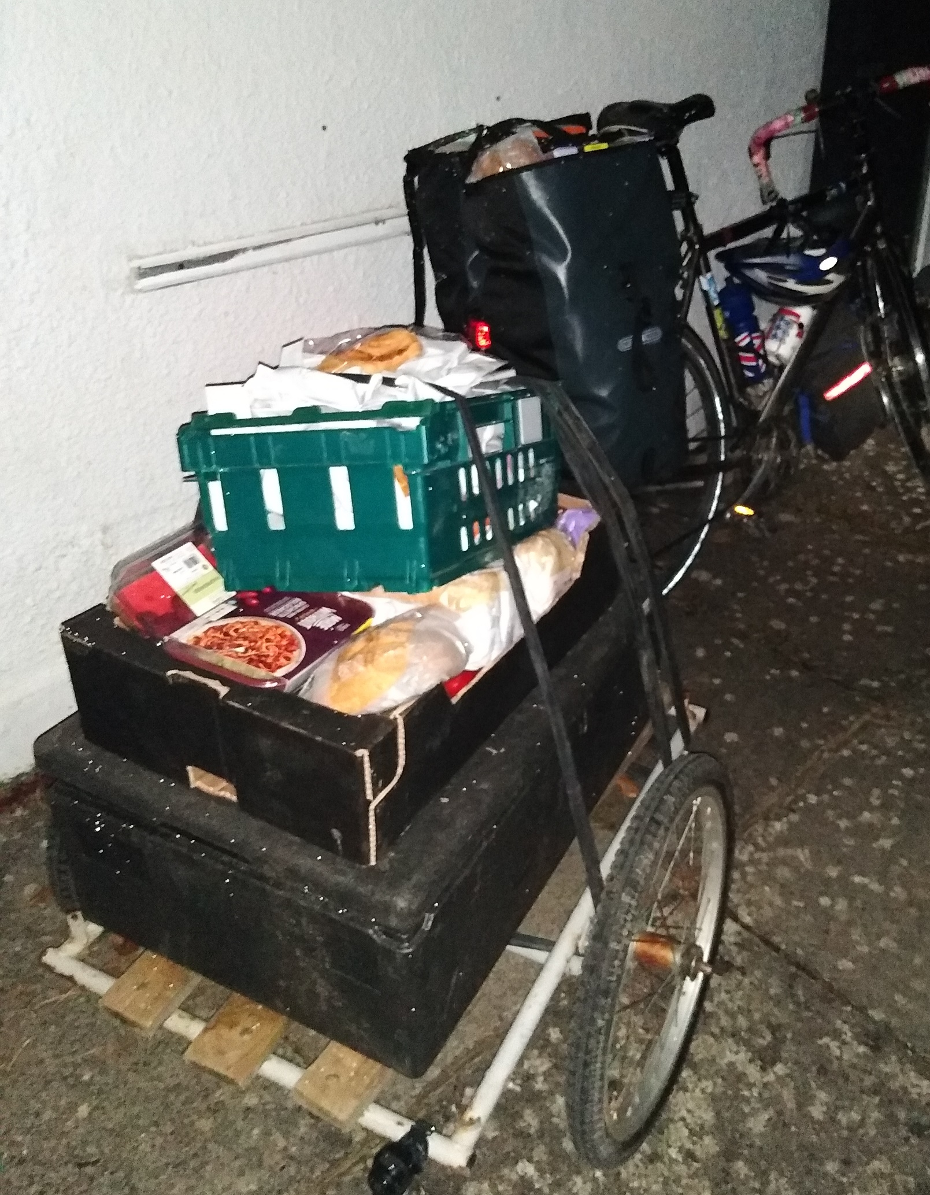
Shopping by bike

Slide 13
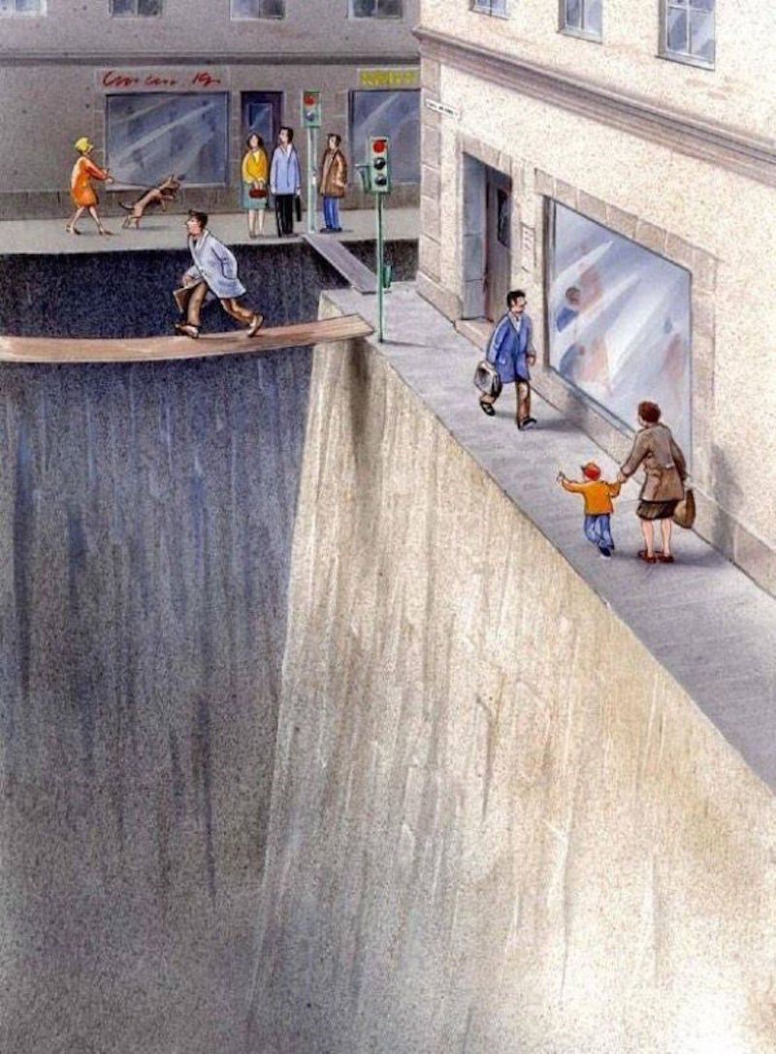
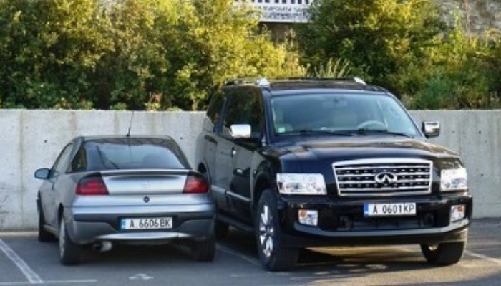
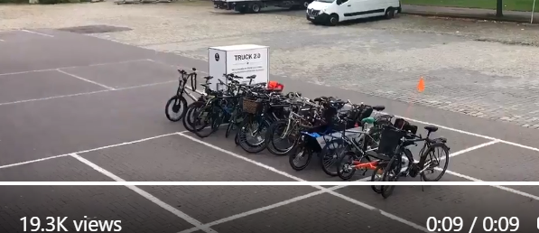

Slide 14
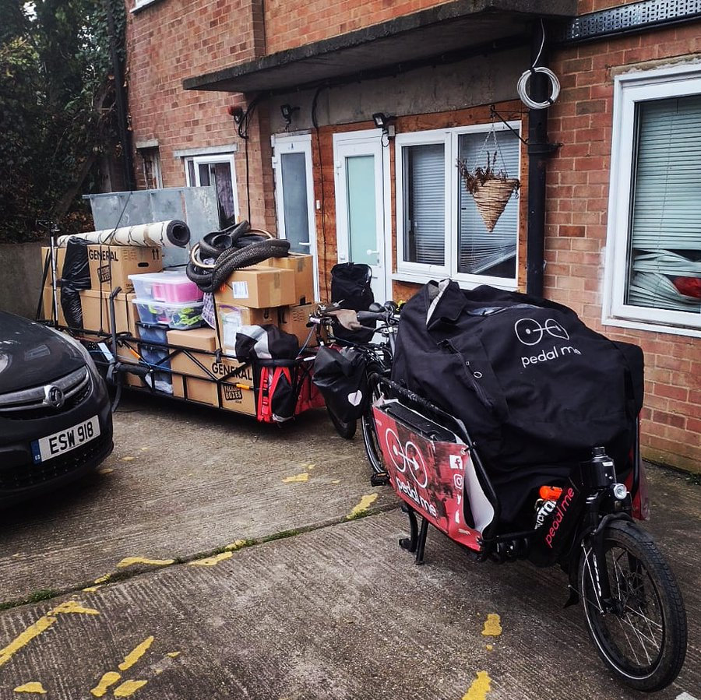
House moving by bike
https://twitter.com/pedalmeapp/status/1332330659222786048/photo/1

Slide 15
