Slide 1
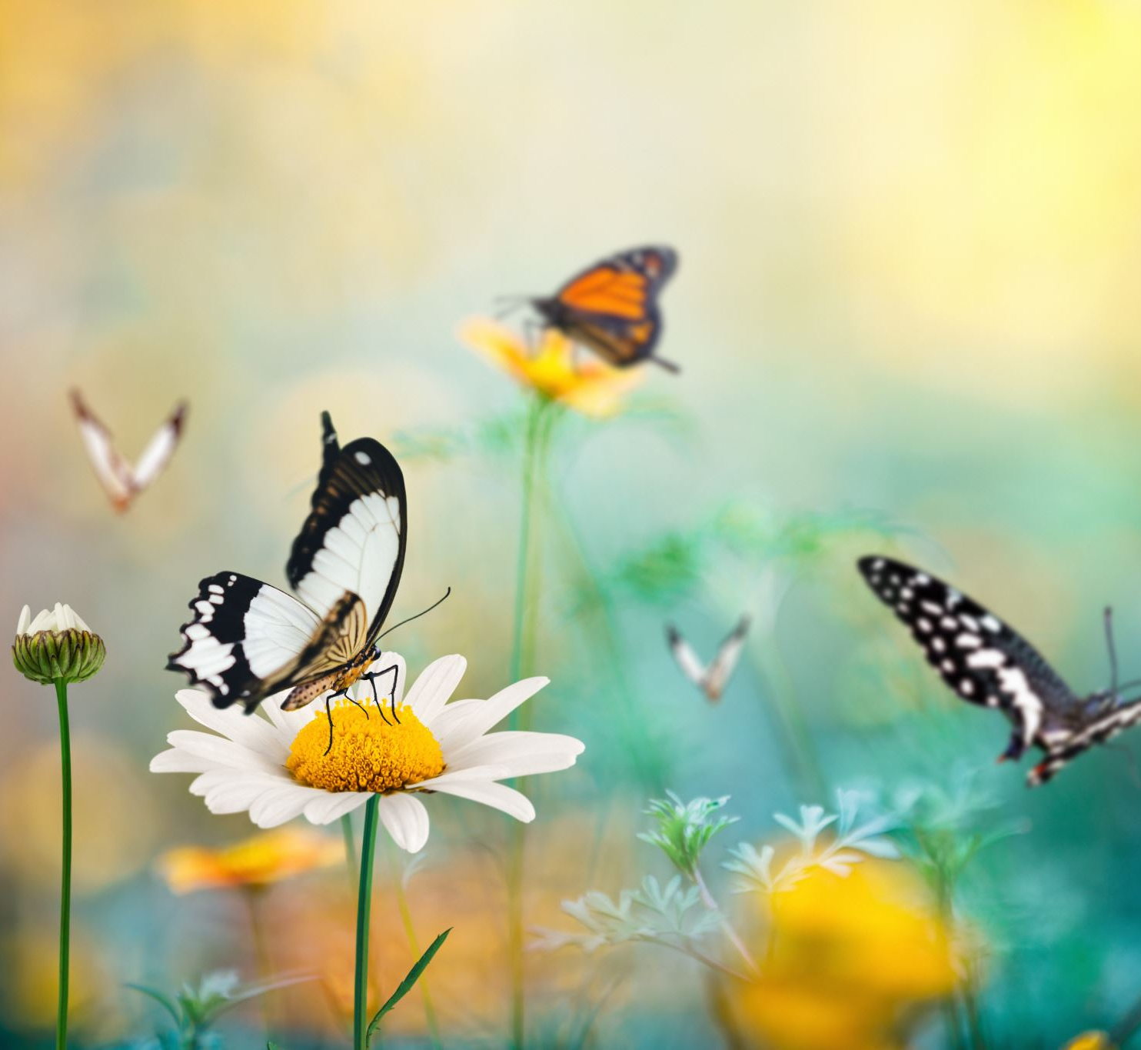
Wildflower Verges
Why they matter
Notes:
1

Slide 2
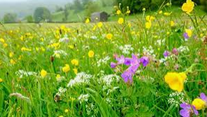
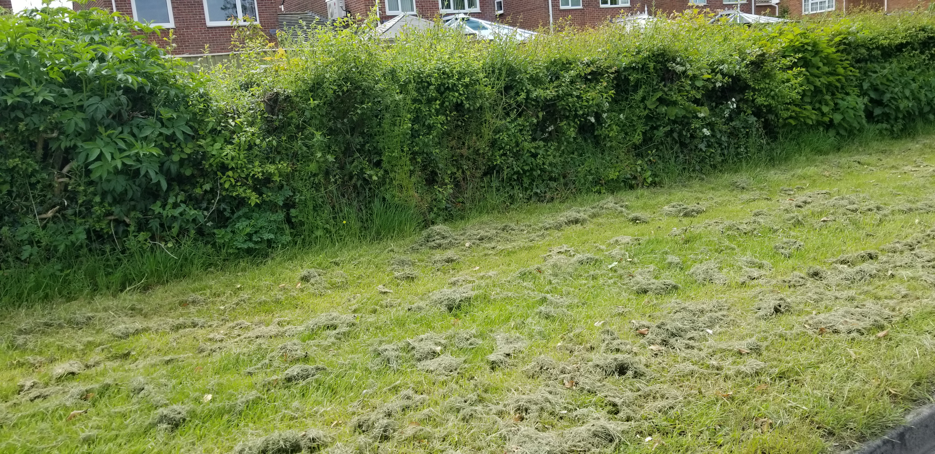
We’ve lost 97% wildflower meadows since 1930s (7.5 million acres or 3 million hectares) due to:
Farming Over 70% of the UK’s land is farmed using fertilisers, pesticides and herbicides.
Development of land. New housing estates, shopping malls, office complexes and roadways have not taken account of how they diminish wildlife areas and corridors
Private Gardens Private gardens in Britain cover an area bigger than all of the country’s nature reserves combined, estimated at over 10 million acres but are more likely to have triple petalled, multi coloured, pesticide impregnated imports than the quintessential English Country Garden.
Why does this matter?
Notes:
Dr Trevor Dines, Plantlife Botanical Specialist, said: "The steady, quiet, and under-reported decline of our meadows is one of the biggest tragedies in the history of UK nature conservation; if over 97% of our woodland had been destroyed there’d be a national outcry.
2

Slide 3
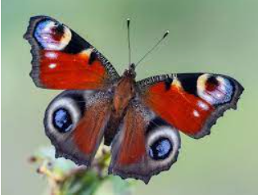
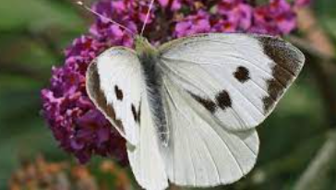
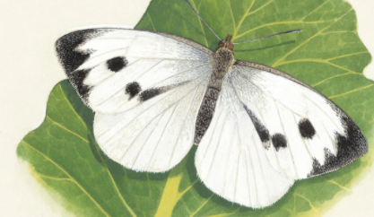
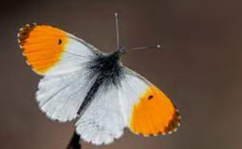
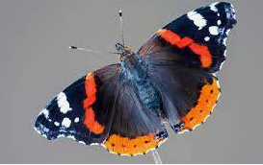
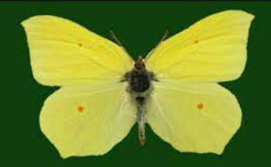
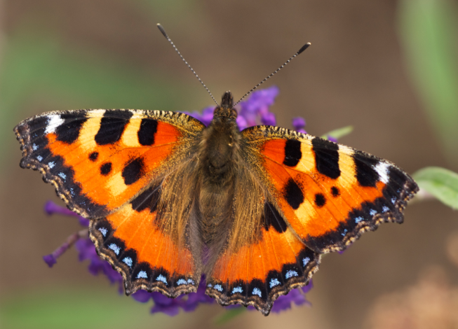
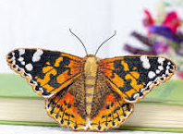
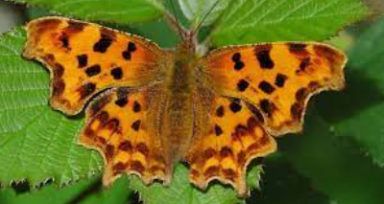
Nearly 1,400 species of pollinators and other insects rely on meadow plants for their survival so it is not surprising to find that insects are in rapid decline. Also due to increased use of insecticides in gardens and farms.
A third of what we eat relies on insect pollination.
Wildflowers can improve soil health, prevent erosion, improve water quality, increase yields and enhance forage conditions for livestock.
Native plants can help decrease pollution because they eliminate the need for mowers and other equipment.
Since lockdown we've found out that wild areas are really good for our mental health.

Slide 4
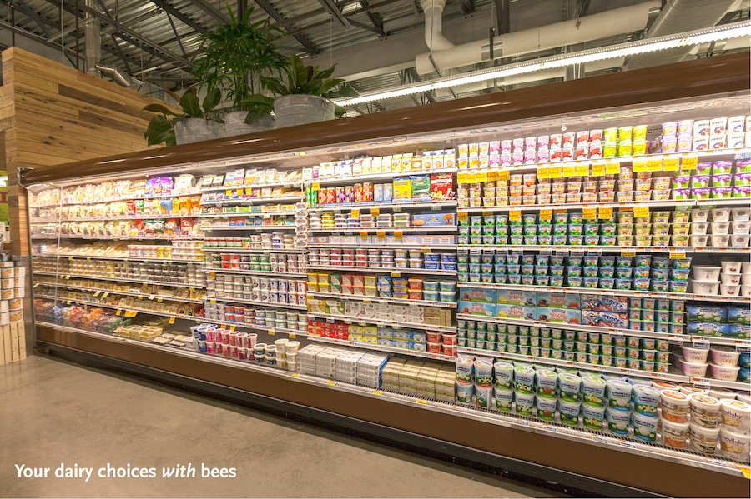
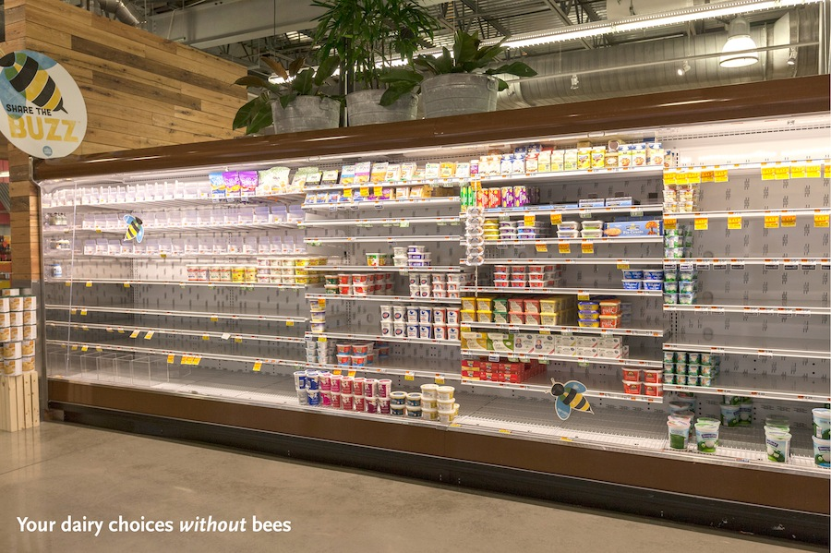
With pollinators
Without pollinators

Slide 5
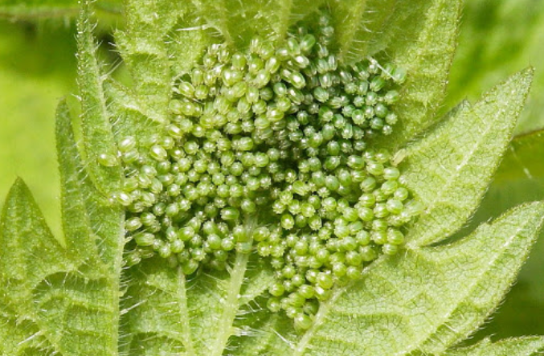
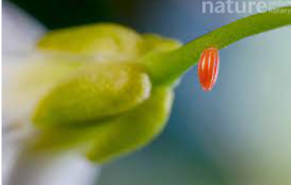
Helping Butterflies Breed
All the butterflies below lay their eggs on
Stinging Nettles or Hops
Red Admiral
Peacock
Small Tortoiseshell
Comma
Painted Lady lays their eggs on nettles, mallows and viper’s bugloss but thistles are the favourite
Brimstone lays their eggs on alder buckthorn or buckthorn
Orange Tip lays their eggs on cuckooflower & garlic mustard
Cabbage White (large & small) lays their eggs on cabbages, broccoli, kale, cauliflower and sprouts & nasturtiums
Photo small tortoiseshell butterfly eggs on a nettle
Photo orange tip egg on a cuckooflower

Slide 6
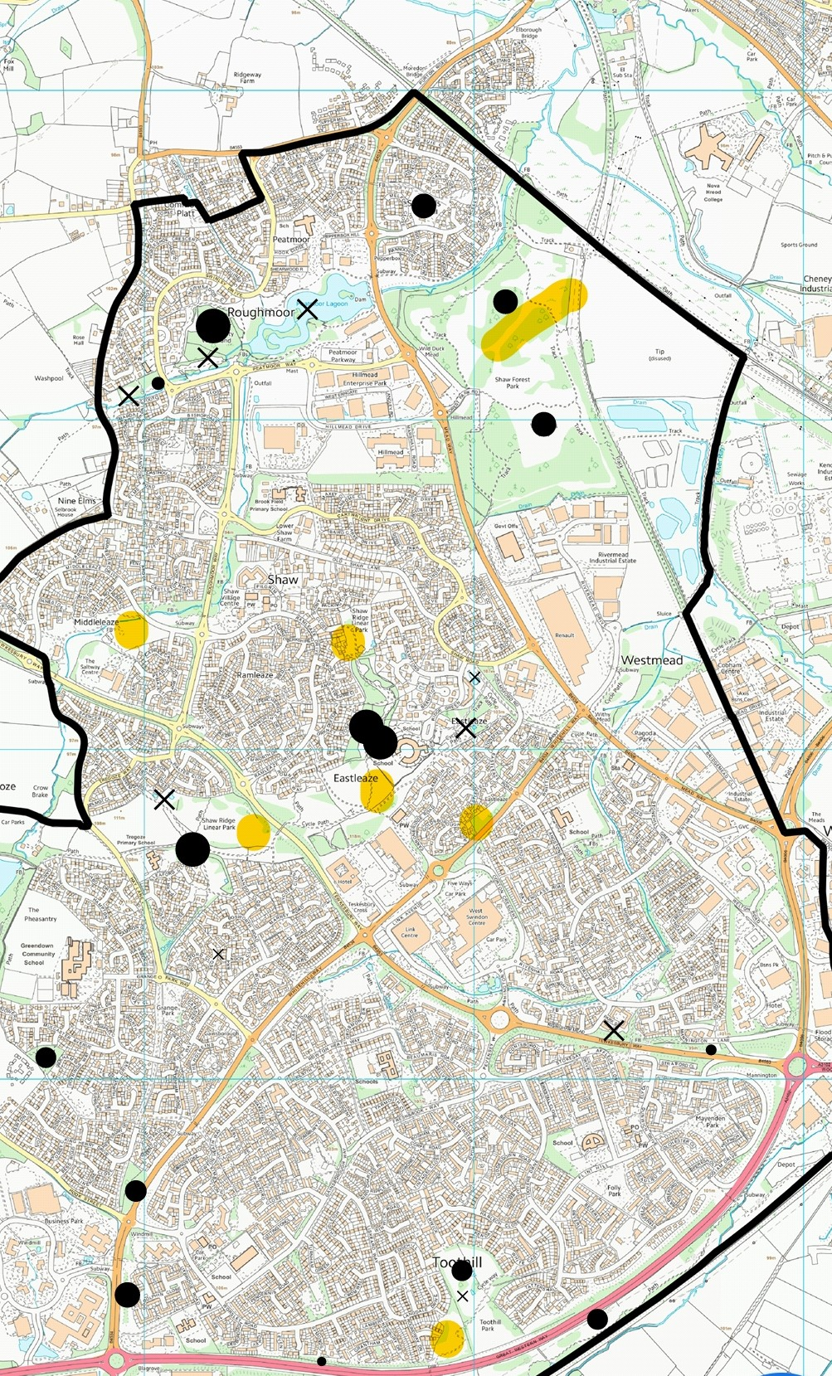
West Swindon Parish
Yellow areas denote sites to be mowed just twice a year. Black areas are copses and X marks natural ponds.

Slide 7
CO2 Absorption – Wildflowers vs Trees
Trees store much of their carbon in their leaves and woody biomass, wildflowers stores most of their carbon underground.
British Woodland stores up to 1.4 tonnes of carbon per year, per hectare, grasslands and meadows can store up to 3 tonnes per year, per hectare.
Grassland locks up to a 1/5 of all soil carbon in UK - considerably more than woodland cover.
Carbon absorbed into the soil by becoming organic matter is more likely to stay ‘locked up’, rather than being released when a tree dies or is chopped down.
Meadows that are cut every year for hay carry on absorbing CO2 each time there is new growth, creating a rich soil full of carbon – and, by not ploughing the land dead roots that are full of carbon can build up and create a humus.
Wildflower meadows take up higher levels of Co2, are considerably quicker to establish
Numerous wildlife benefits associated with meadows, such as providing food for pollinators, other invertebrates and farmland birds.
When wildfires burn trees, their carbon is released back to the atmosphere. When fire burns grasslands, the carbon fixed underground tends to stay in the roots and soil, making them more adaptive to climate change.
Need a mix of forest and wildflower meadows as trees have other benefits.
Notes:
Point 1
University of California
Points 2-7
Miles King (Director of Conservation at The Grasslands Trust)
7

Slide 8
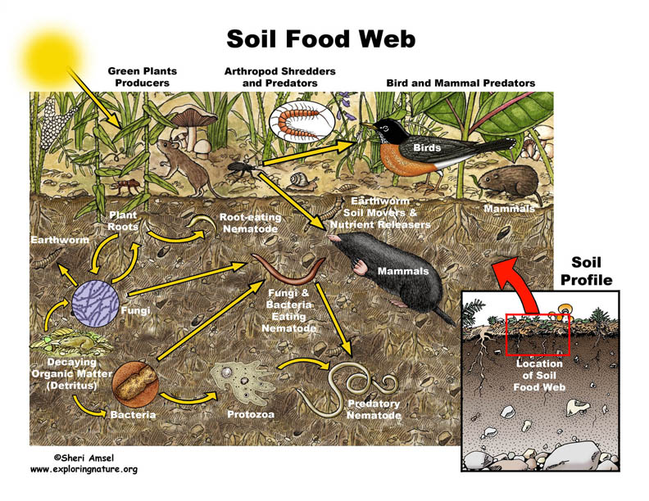

Slide 9
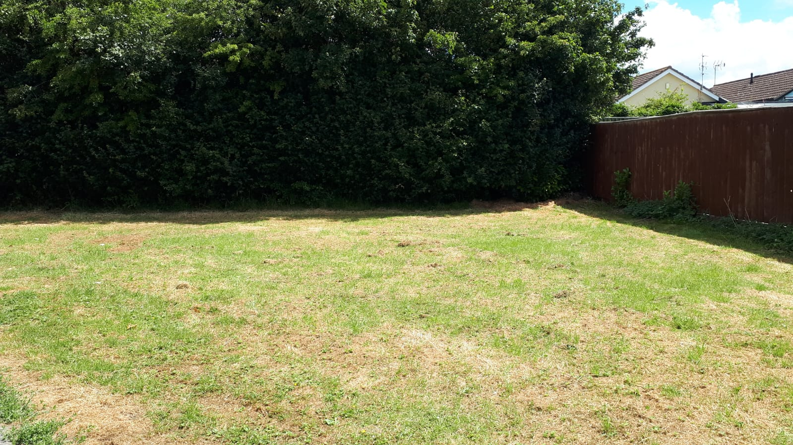
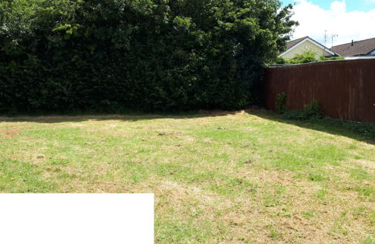
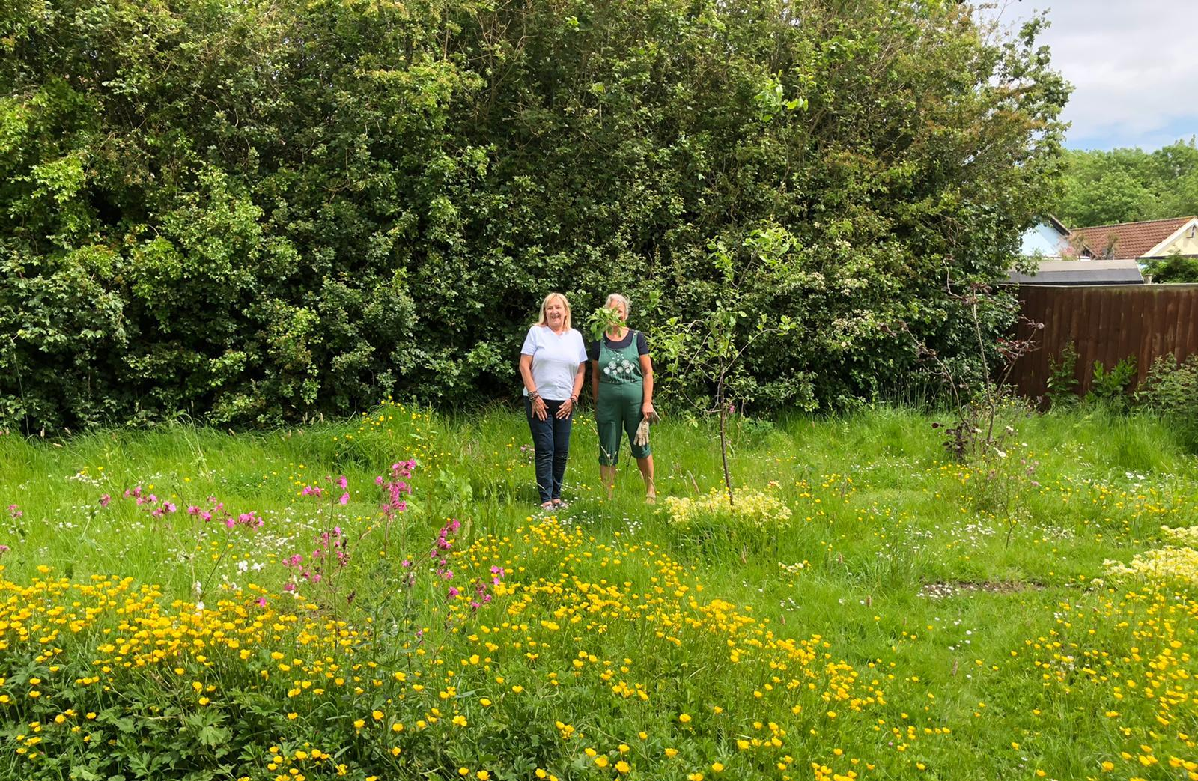
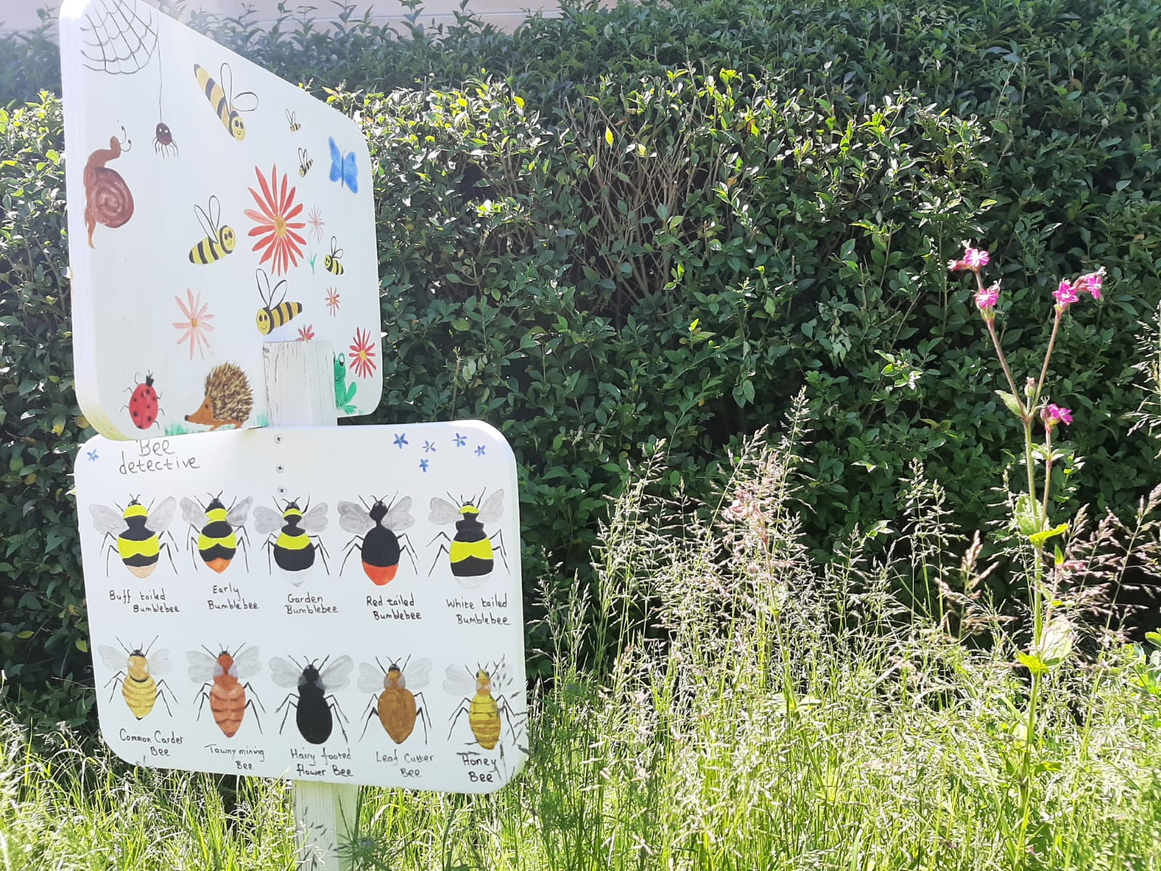
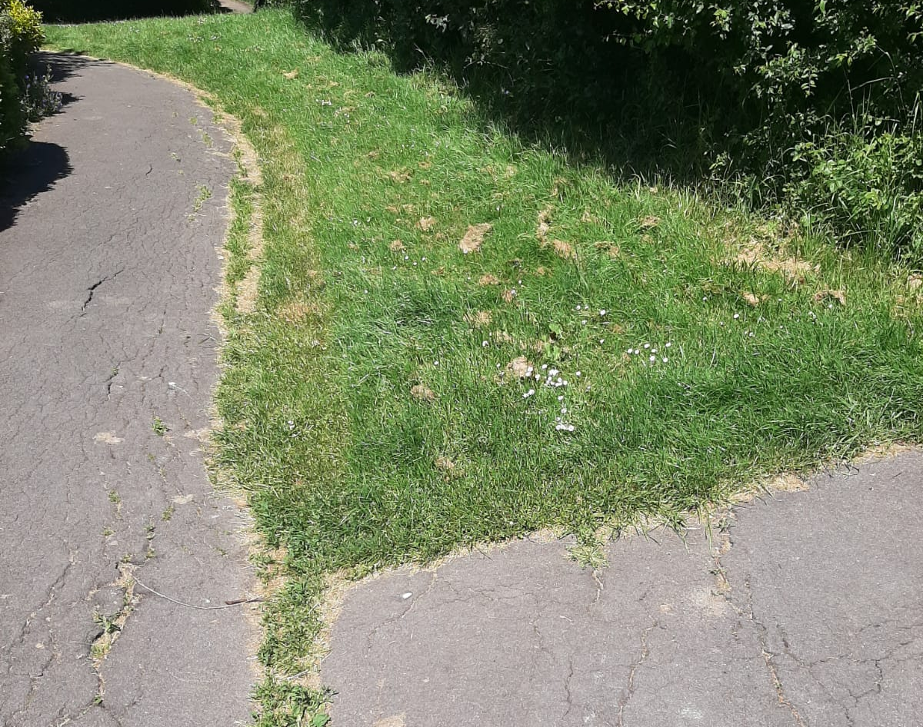
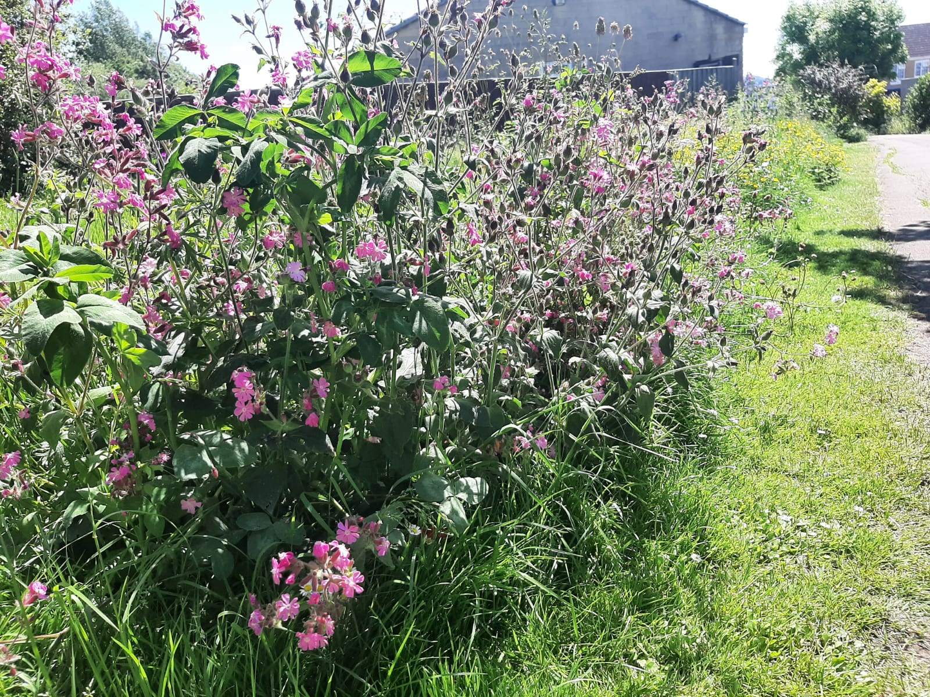
Edgehill Haven

Slide 10
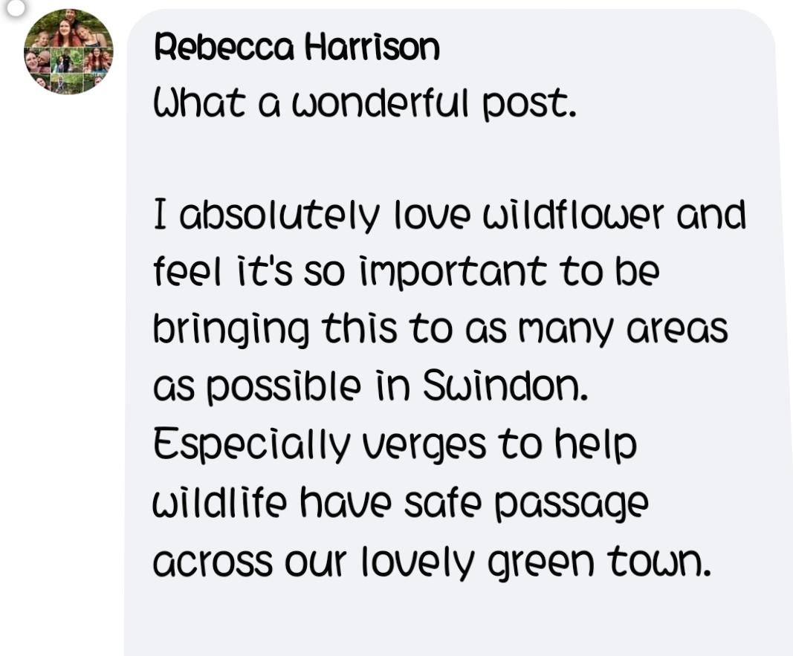
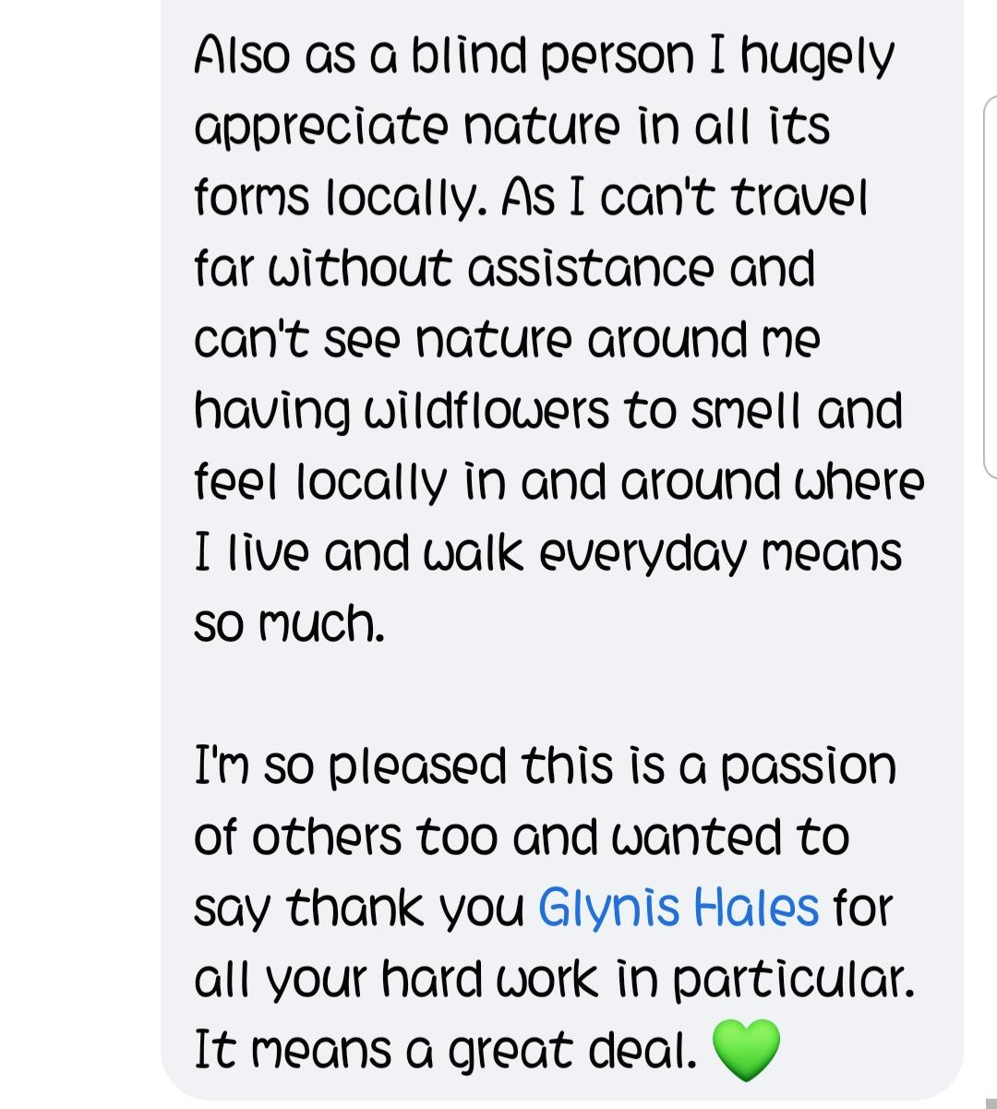
But there’s other reasons for wildflower verges

